Slide 1
Introduction to Computing for Data Analysis
Does my (numerical) program compute the right answer?
Richard Vuduc, Ph.D.
Associate Professor
School of Computational Science and Engineering
A framework for error analysis
Notes:
You now know a lot of detail about how numbers are stored.
But to show that a numerical program is correct, you’d like to avoid thinking about too many of those details, at least while you are trying to develop an algorithm.
So, in this lesson, you’ll get an overview of a high-level mathematical framework for analyzing errors.
Ok, so let’s get started.

Slide 2
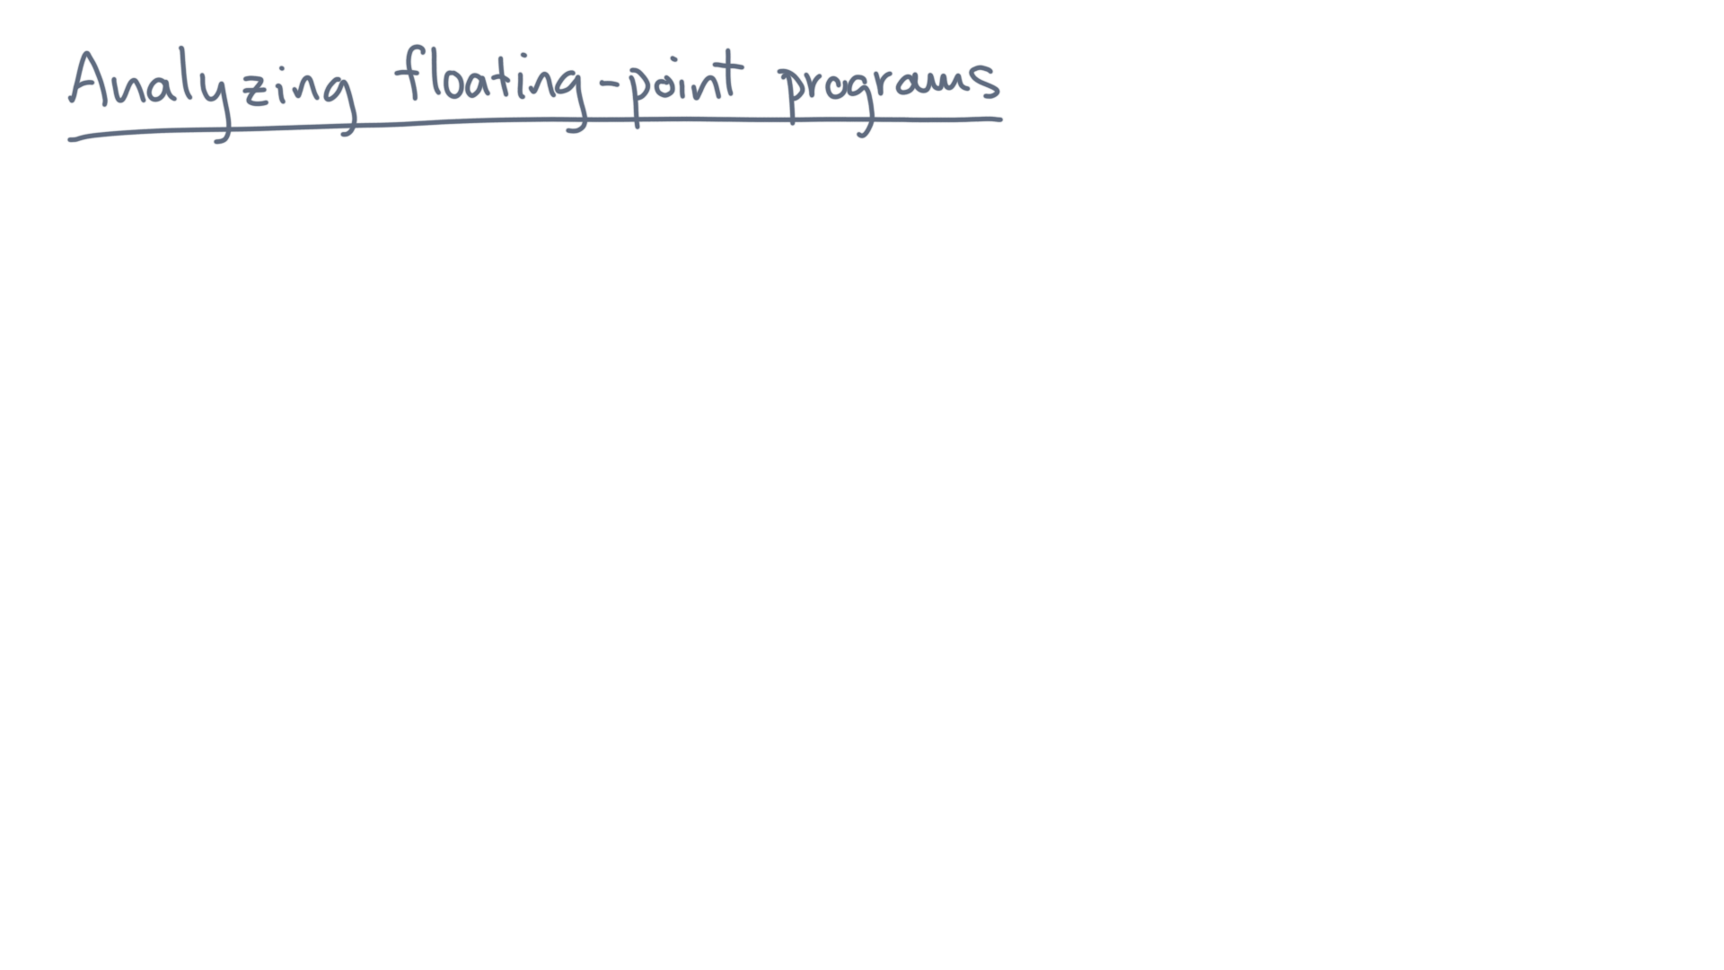
Notes:
Here is the setup.

Slide 3
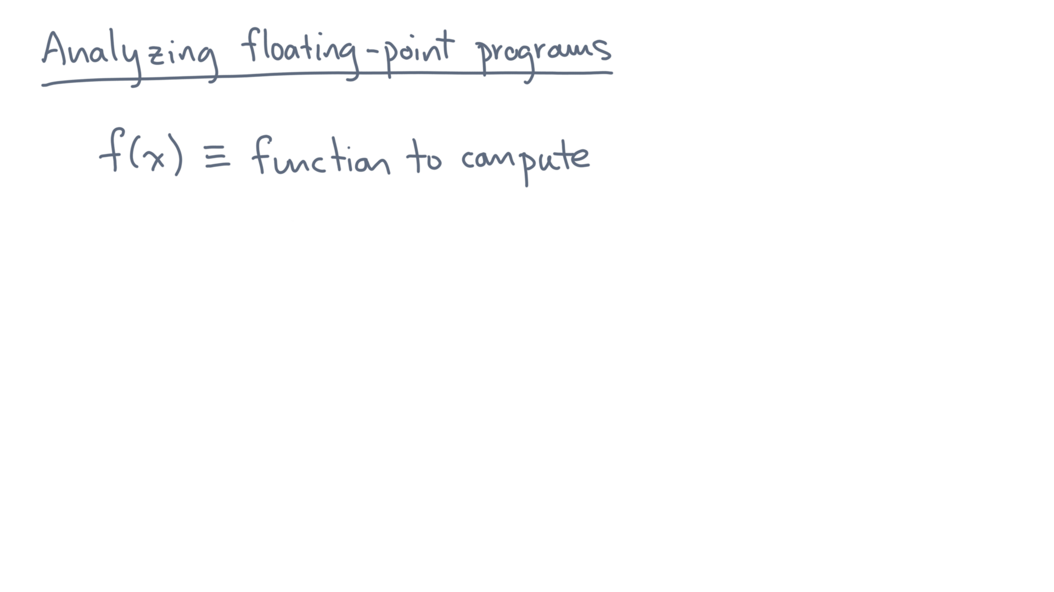
Notes:
Suppose f(x) is the exact mathematical function you want to calculate.
And what you’ve done is to write an algorithm or program.

Slide 4
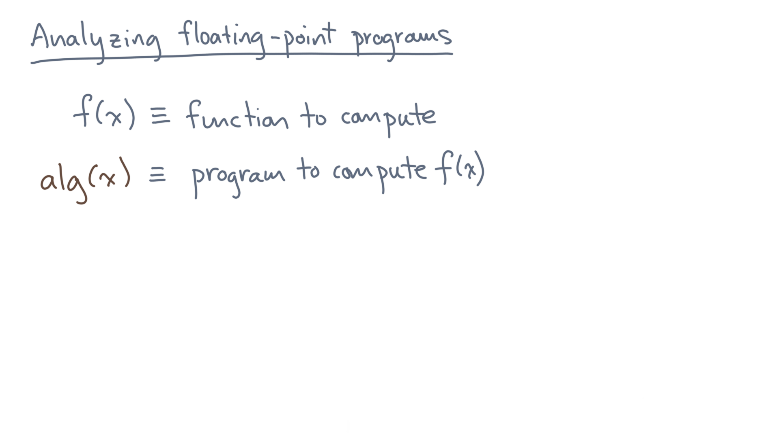
Notes:
Let’s call that algorithm or program, “alg-of-x”.
Since you can’t represent real numbers exactly, you know from the outset that alg(x) must approximate f(x).

Slide 5
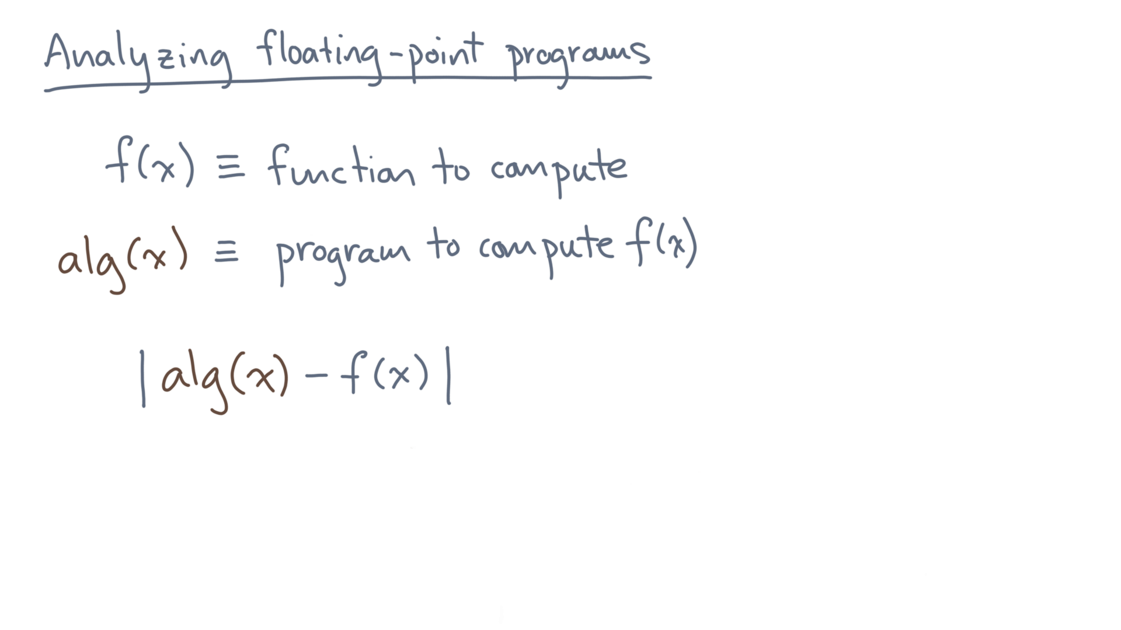
Notes:
Let’s consider the absolute difference between them.
How large could that be?

Slide 6
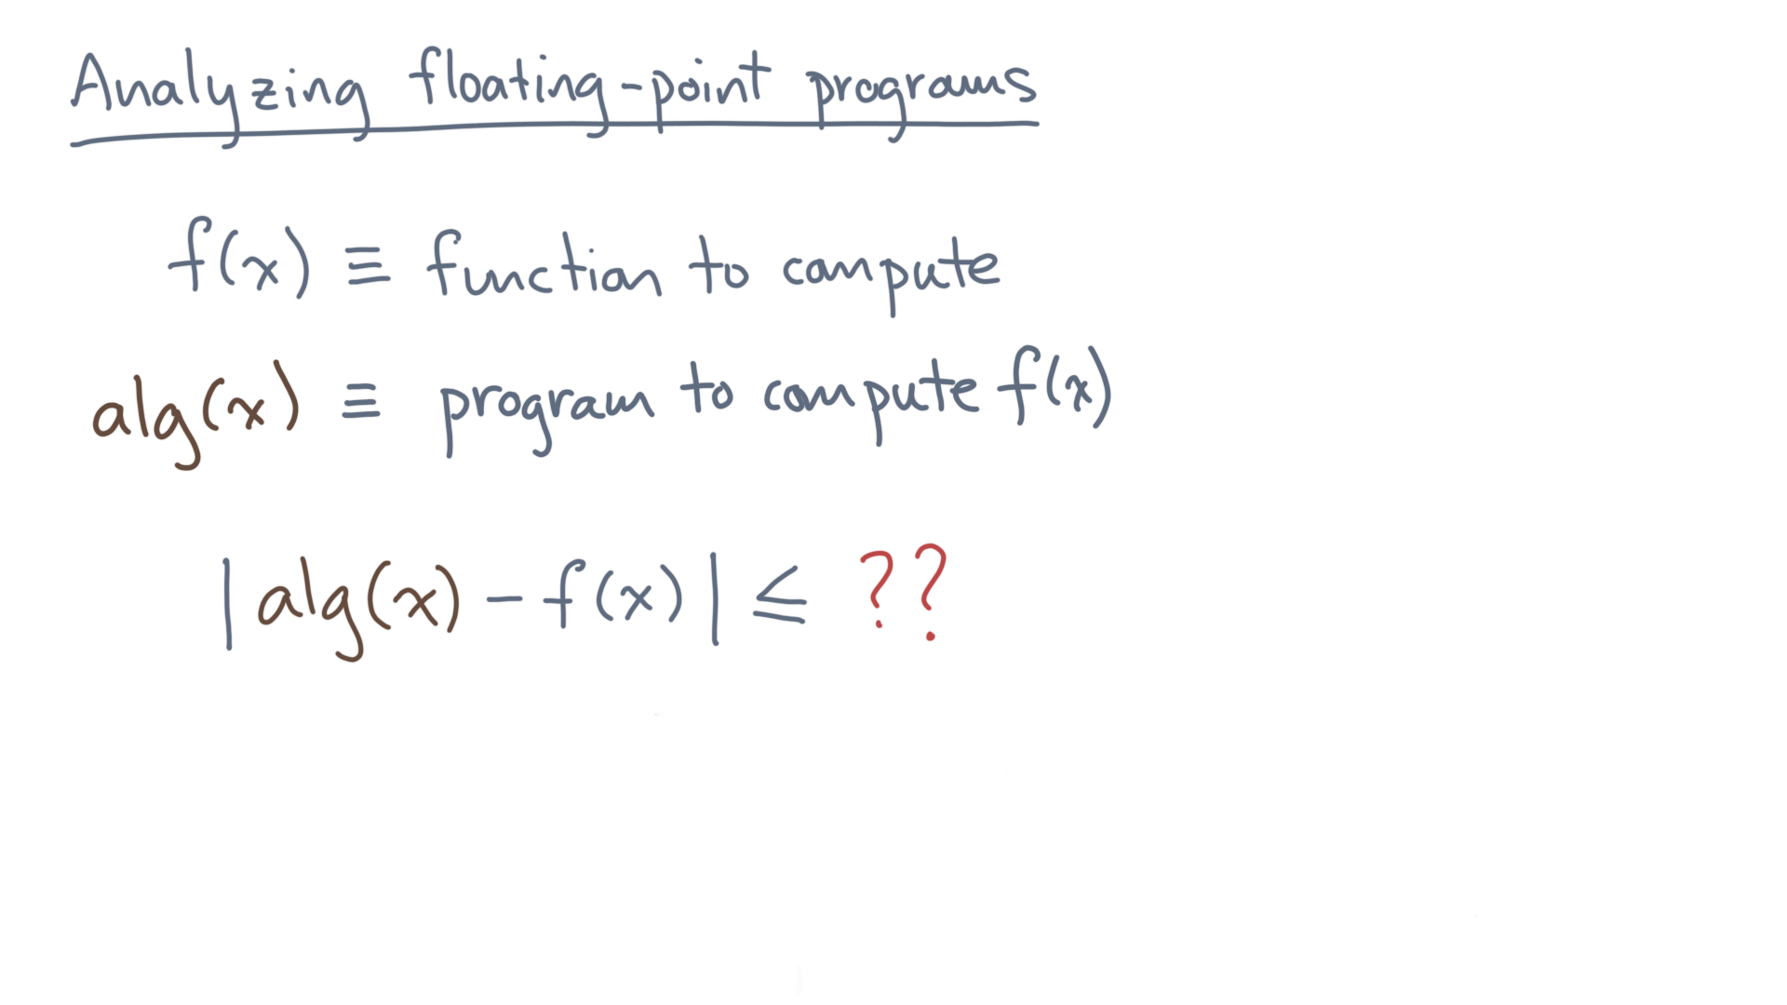
Notes:
If we could bound the absolute error, that would tell us whether we had a sufficiently accurate algorithm.

Slide 7
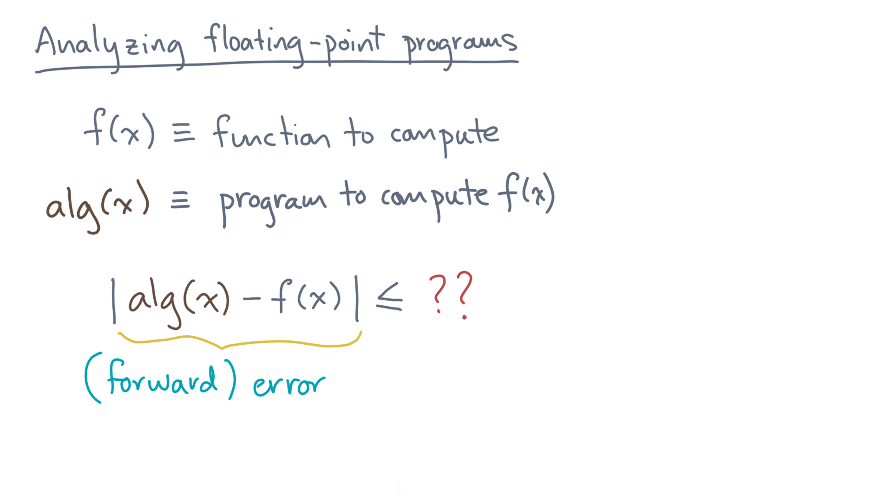
Notes:
This absolute difference is called the “forward error.”

Slide 8
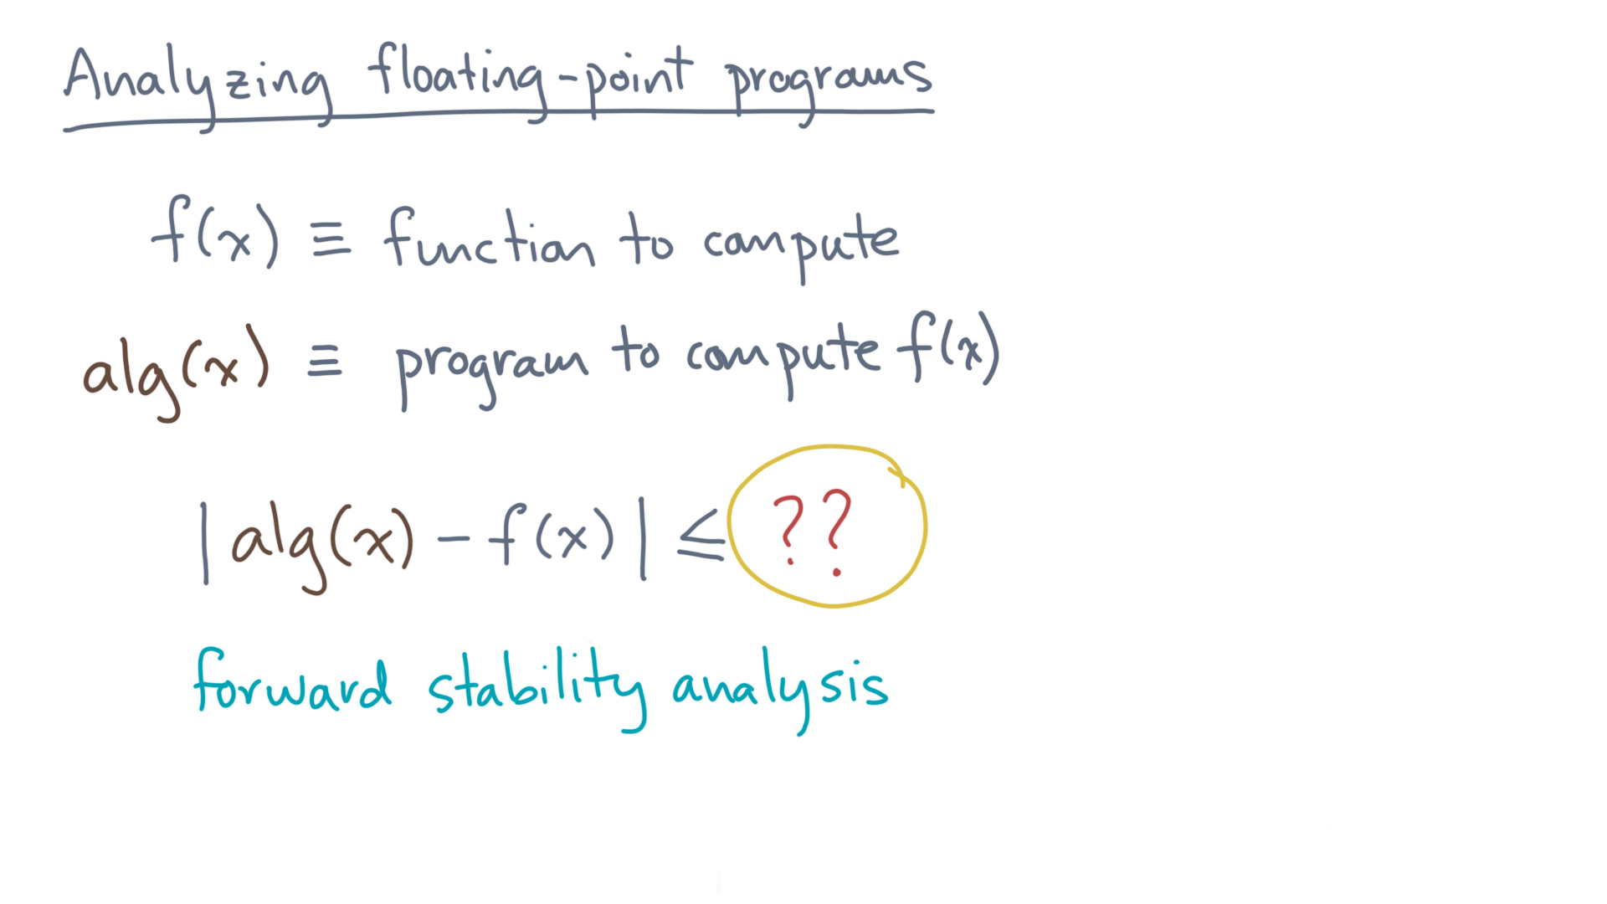
Notes:
And if you manage to calculate an upper-bound on the forward error, you’ve done a “forward stability analysis.”

Slide 9
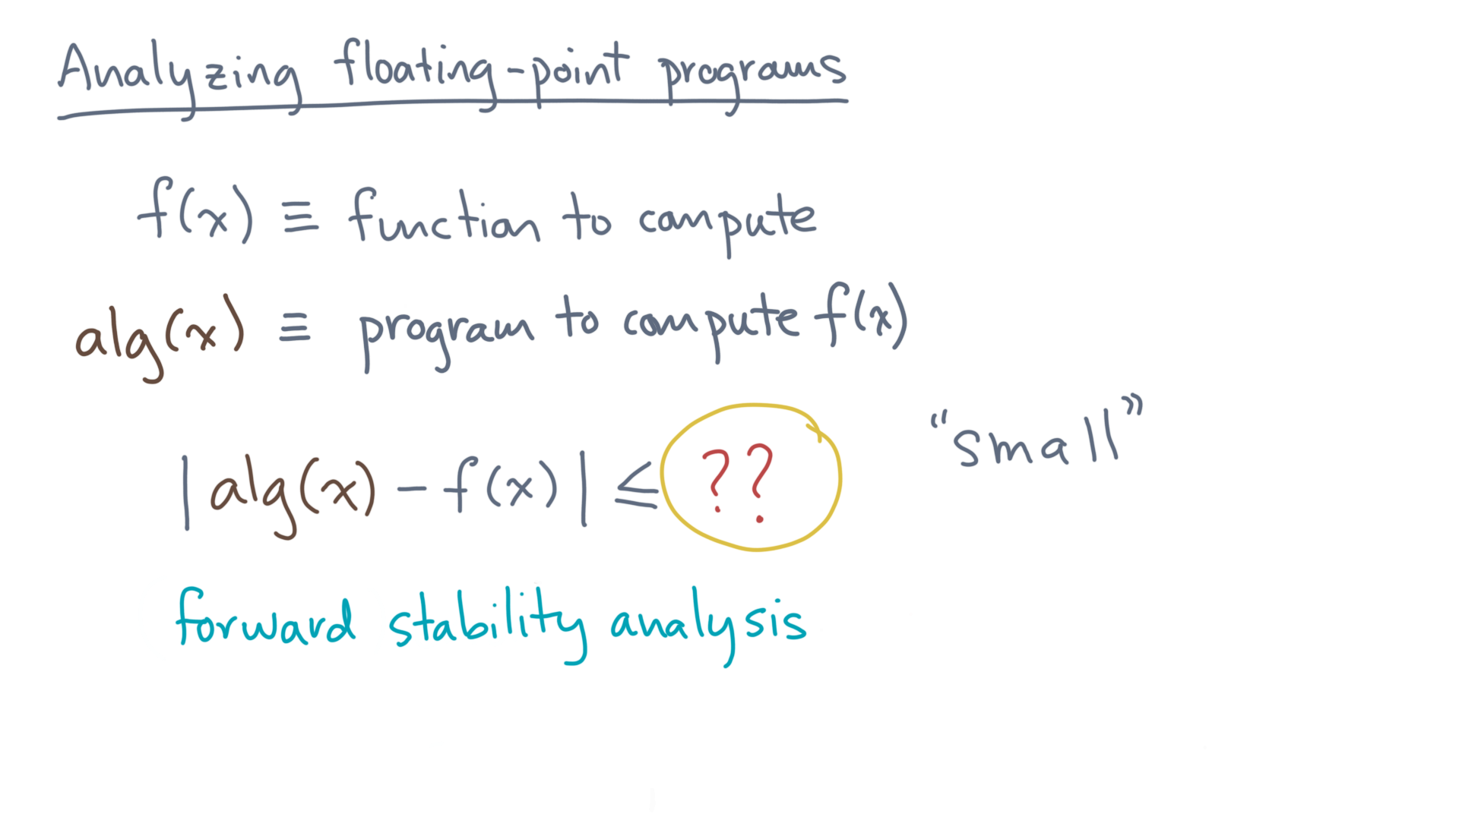
Notes:
Naturally, your goal is to show that the forward error is “small.”

Slide 10
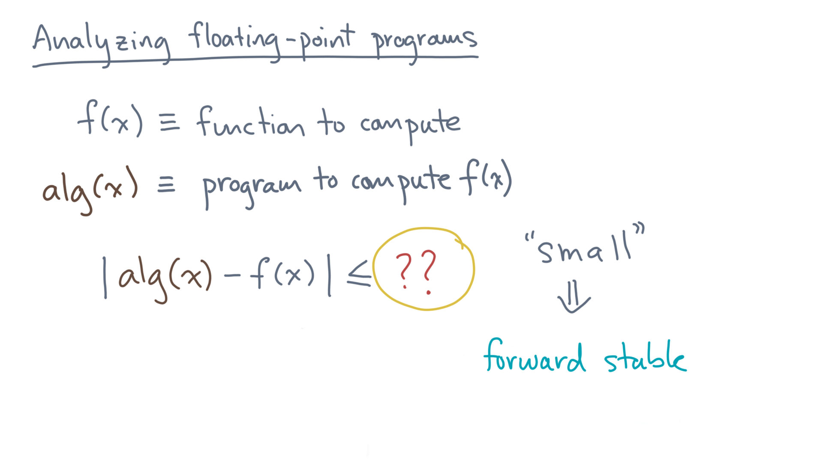
Notes:
If you manage to do that, then you can claim that your algorithm or program is “forward stable.”

Slide 11
Notes:
Ok, so that’s one kind of analysis.
But sometimes it can be very hard to calculate the forward error.
If so, here is something else you can try.

Slide 12
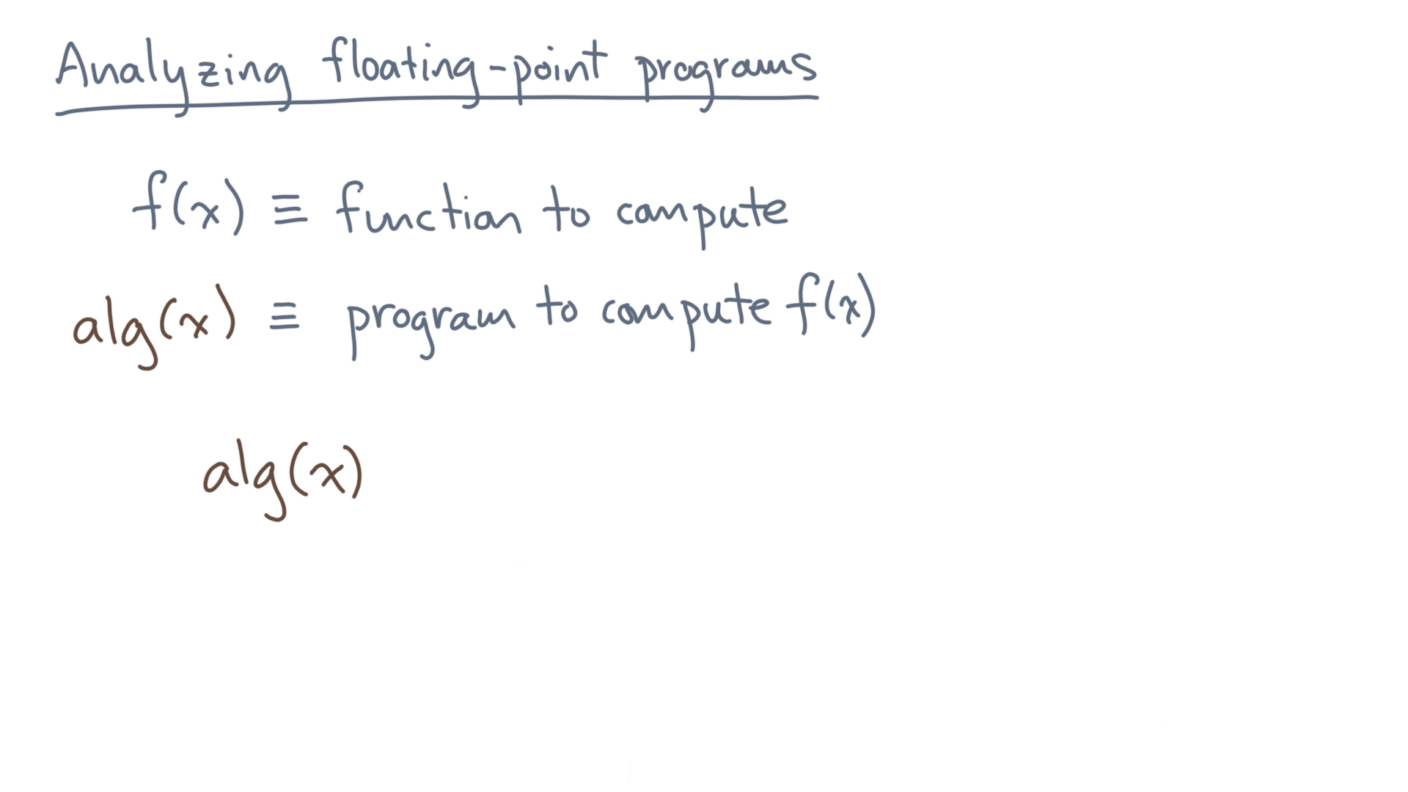
Notes:
Let’s start with your program.

Slide 13
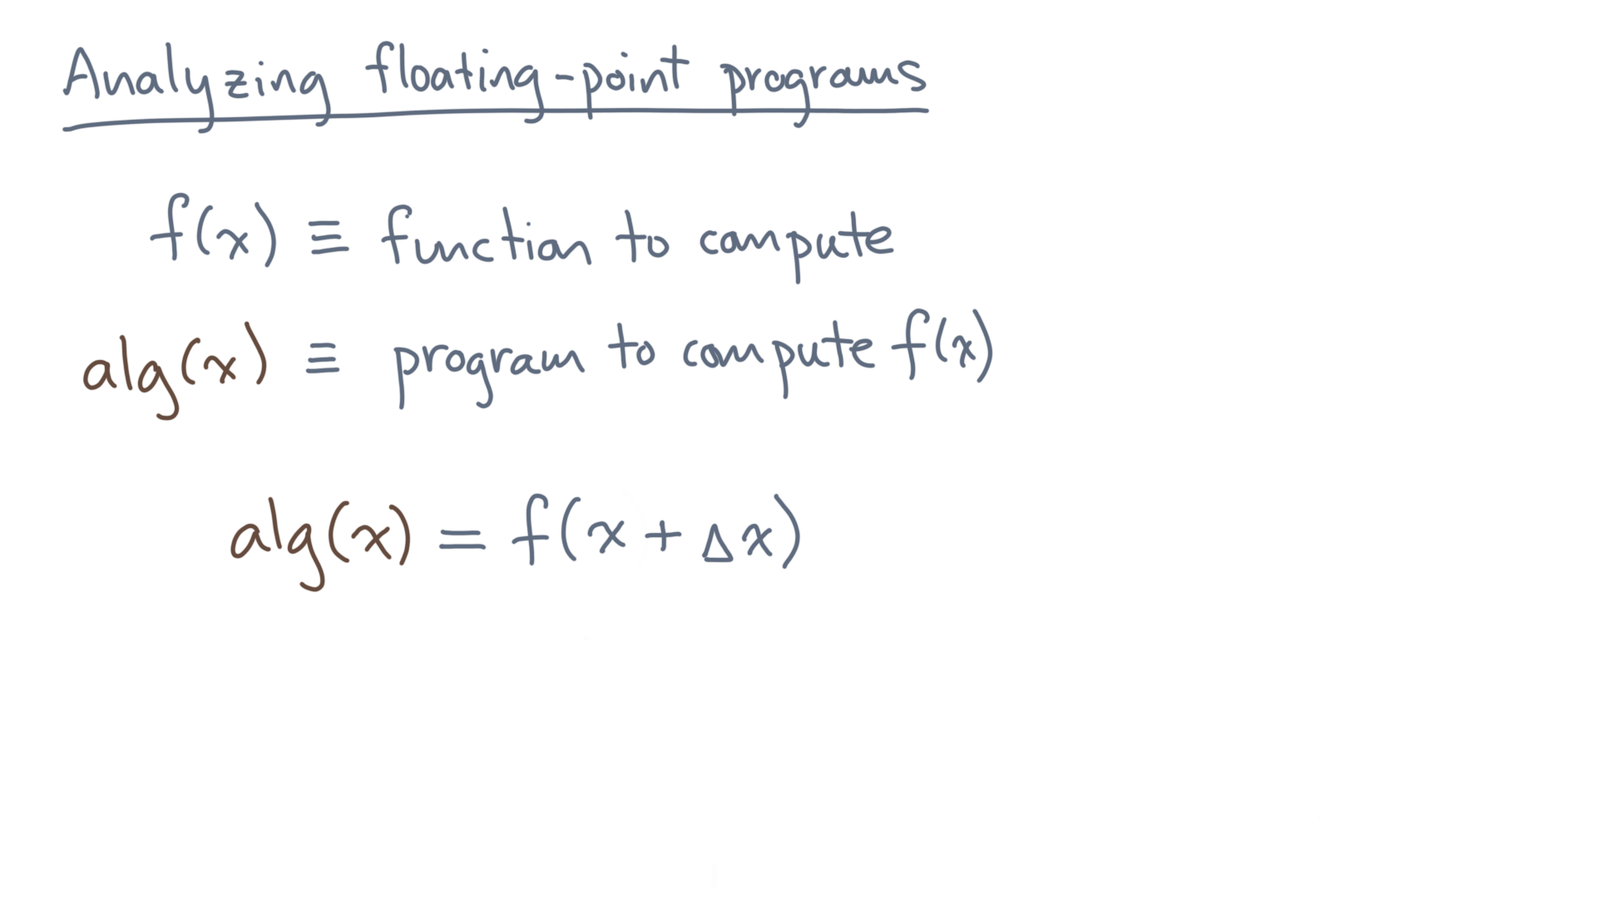
Notes:
What if you can show that it computes the *exact* answer, albeit to a slightly “wrong” problem?

Slide 14
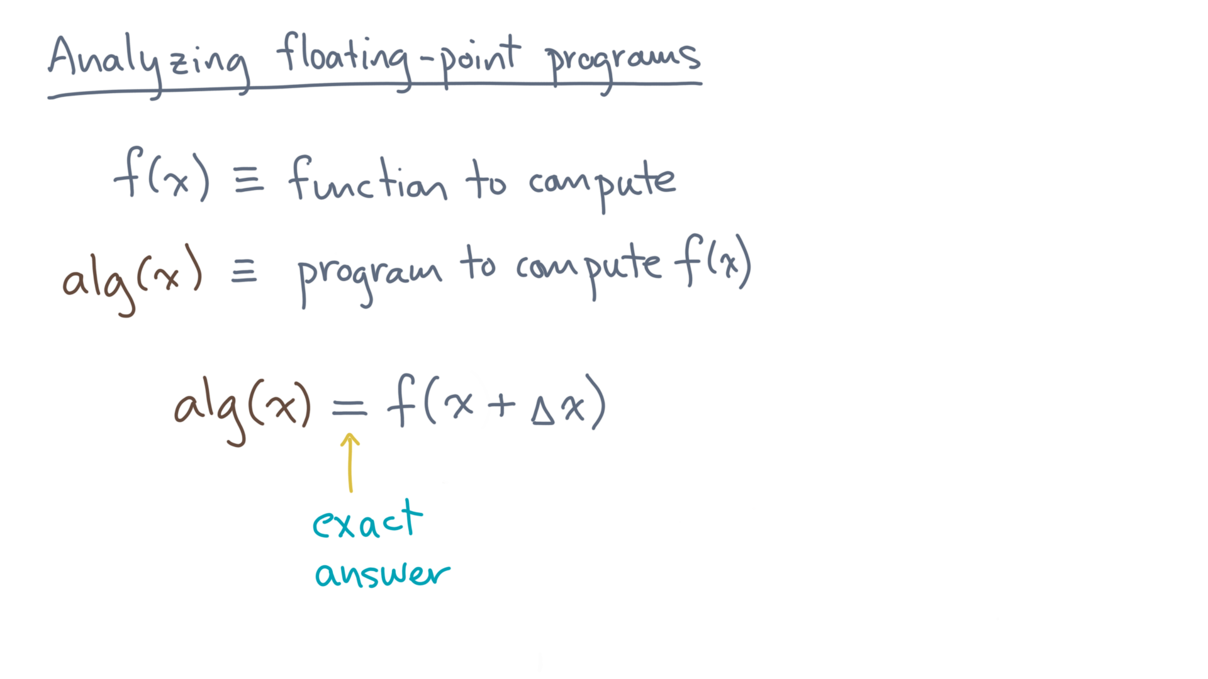
Notes:
That is, what if you can show that alg(x) is exactly f(x + delta x), for some delta x?

Slide 15
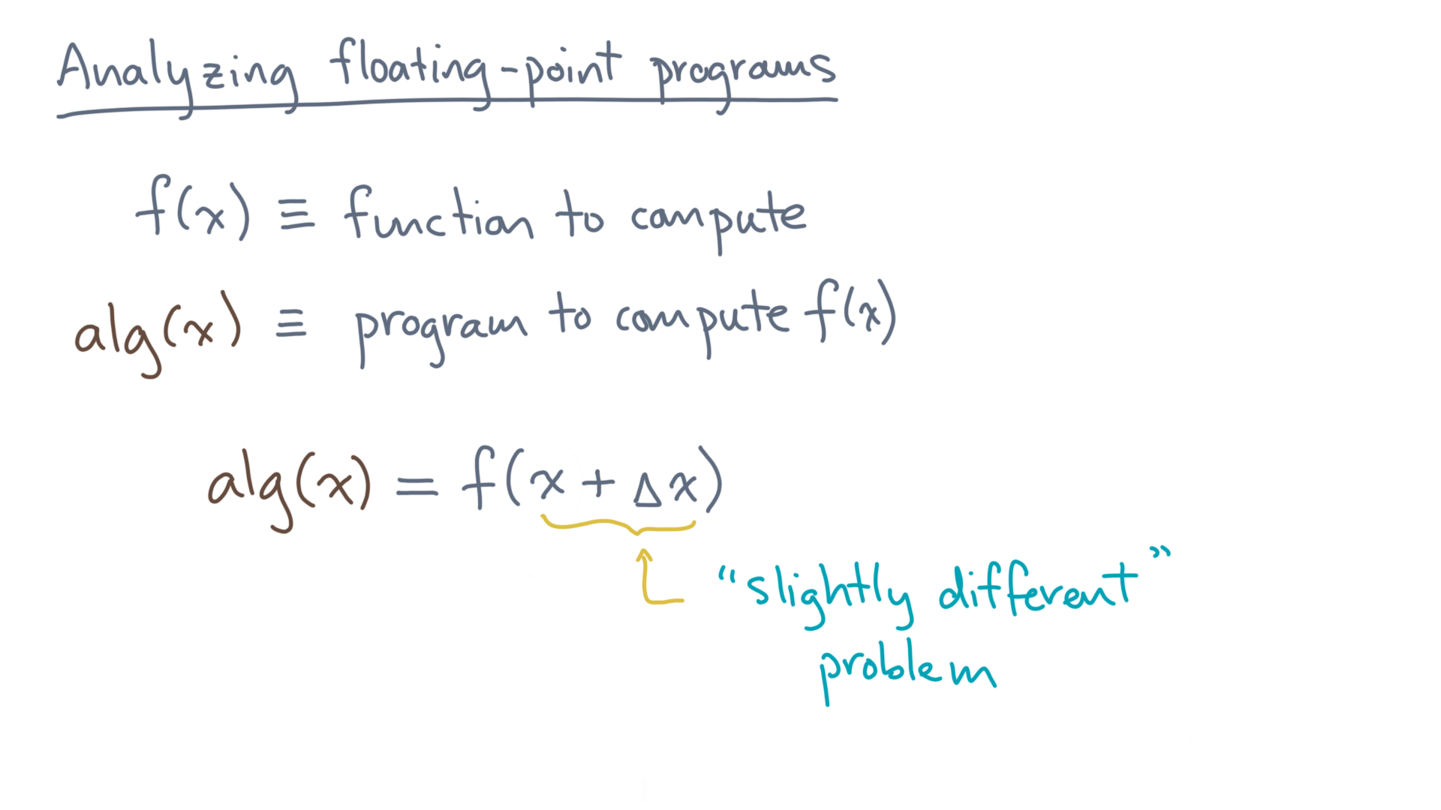
Notes:
This style of analysis is called a “backward stability analysis.”

Slide 16
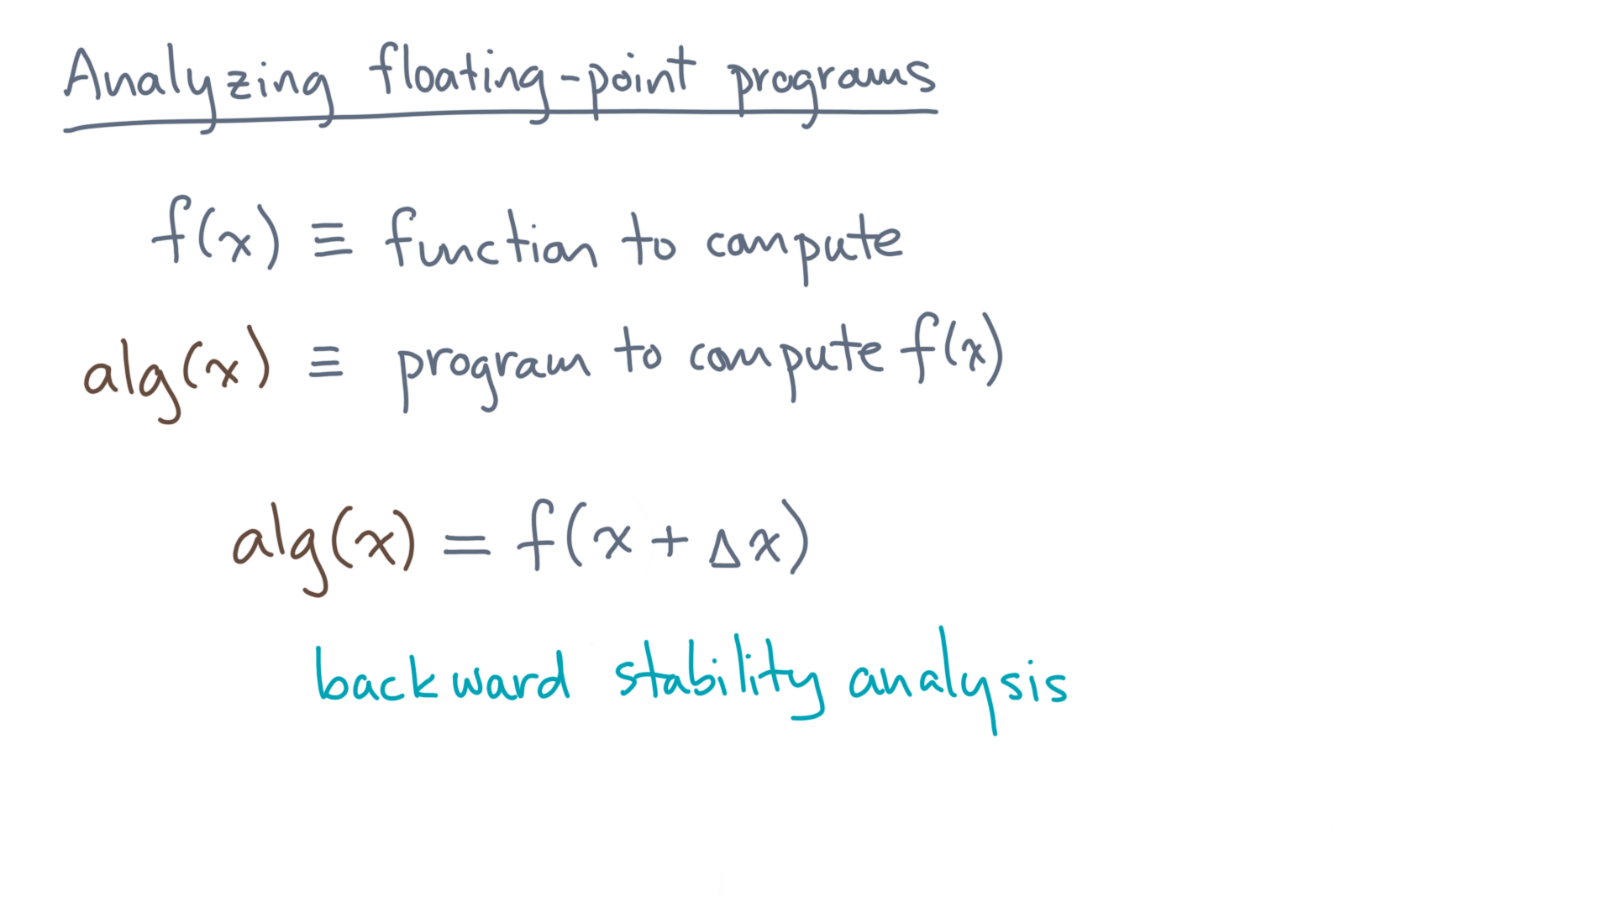

Slide 17
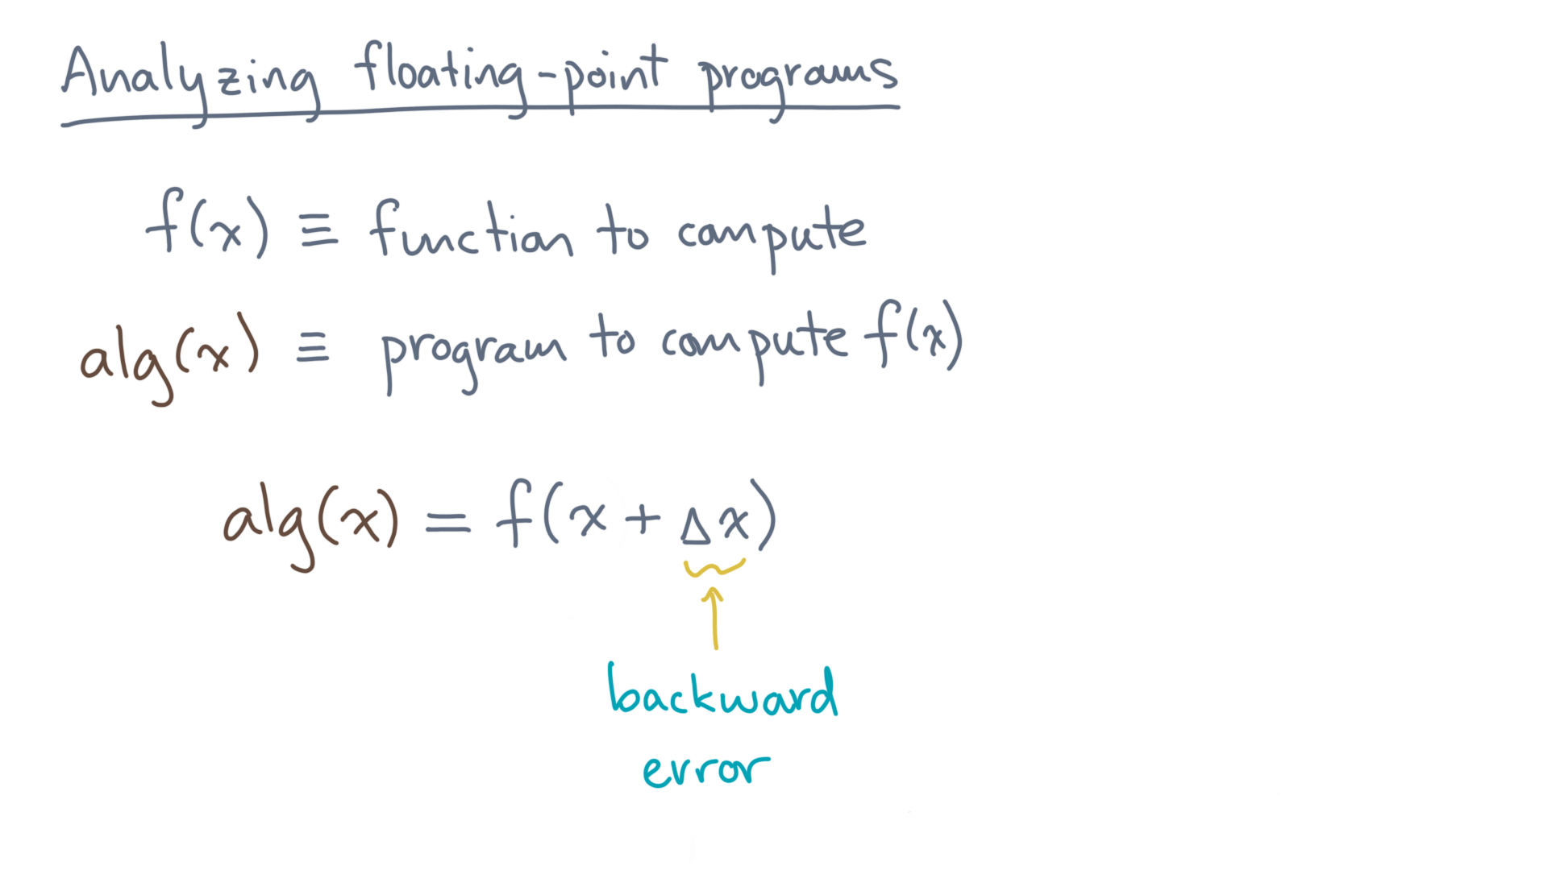
Notes:
And Delta x is called the “backward error.”

Slide 18
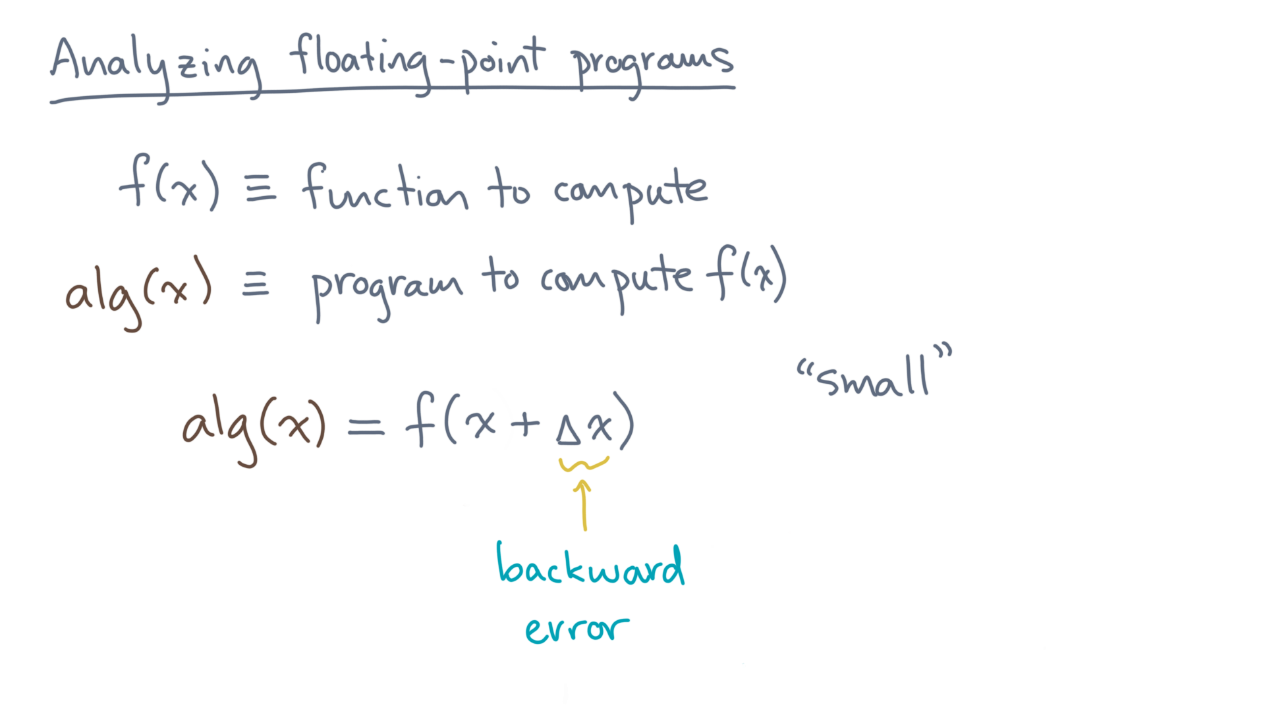
Notes:
In this kind of analysis, your goal is to show that the backward error is small, again, whatever “small” means.

Slide 19
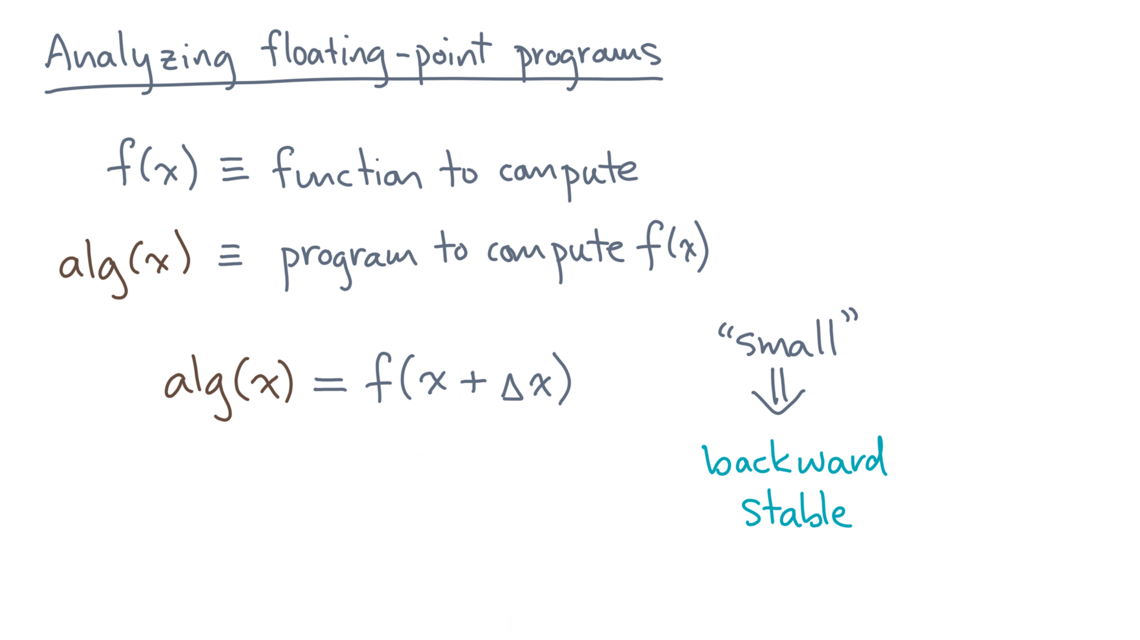
Notes:
And if you manage to do that, then you can conclude your algorithm or program is “backward stable.”

Slide 20
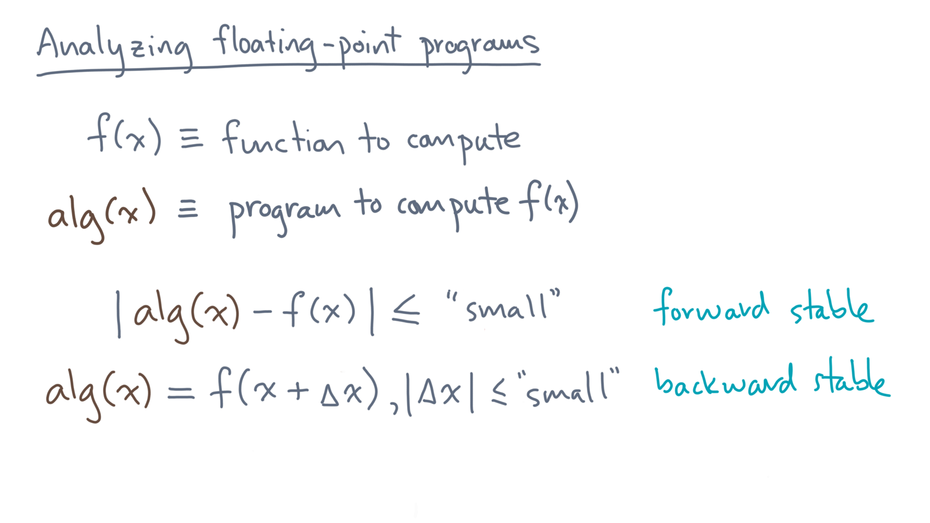
Notes:
So to recap, you will consider two analysis options, forward stability and backward stability.
Sometimes one is easier to do than the other, though it’s often not obvious which to choose.
Though for data analysis, one might argue backward stability is slightly more “natural.” Why?

Slide 21
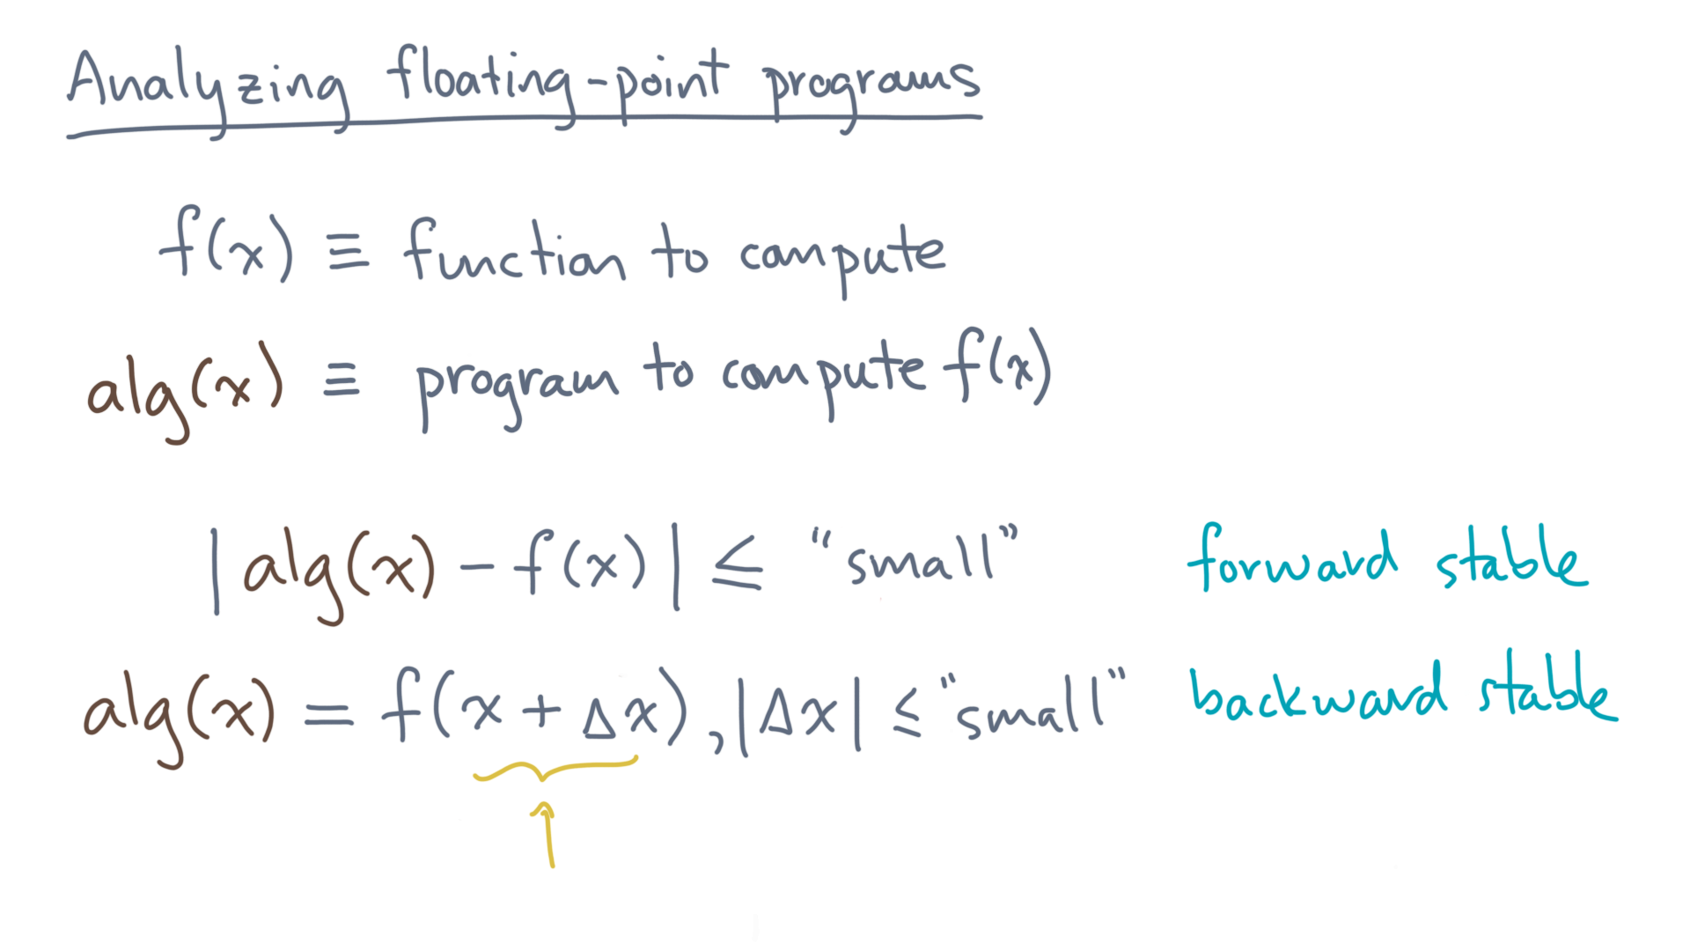
Notes:
Well, think about what it means.
“x” represents the input data, which is often noisy.
So if your program produces an answer that is within that noise, which is delta x, then you might feel perfectly fine using it.

Slide 22
Notes:
As a brief aside, and since the backward error may at first glance seem unnatural, let me motivate its analysis in a different way.

Slide 23
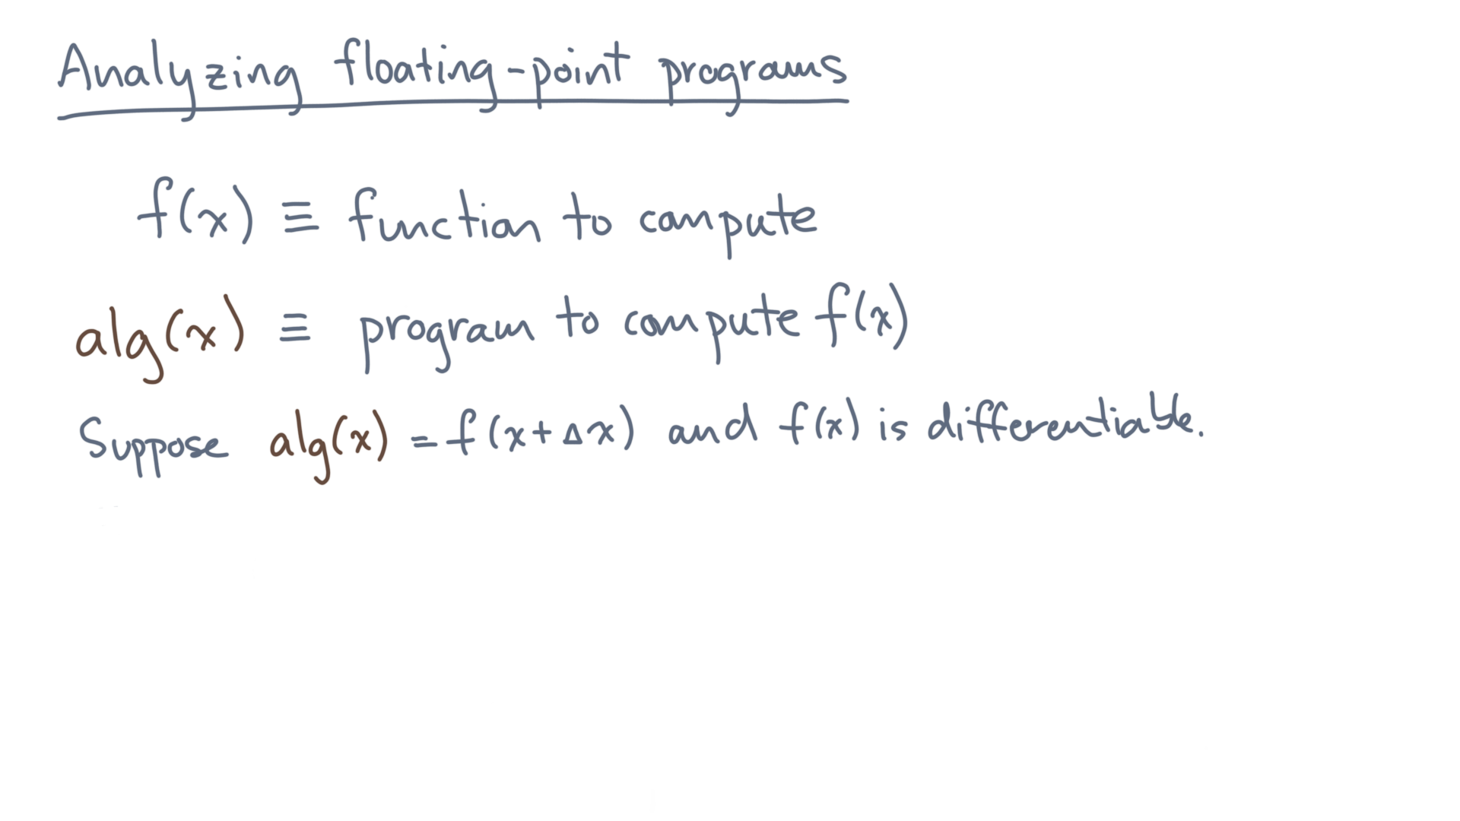
Notes:
Suppose the program is a perturbation of the true function, and furthermore that the true function is smooth and differentiable everywhere.

Slide 24
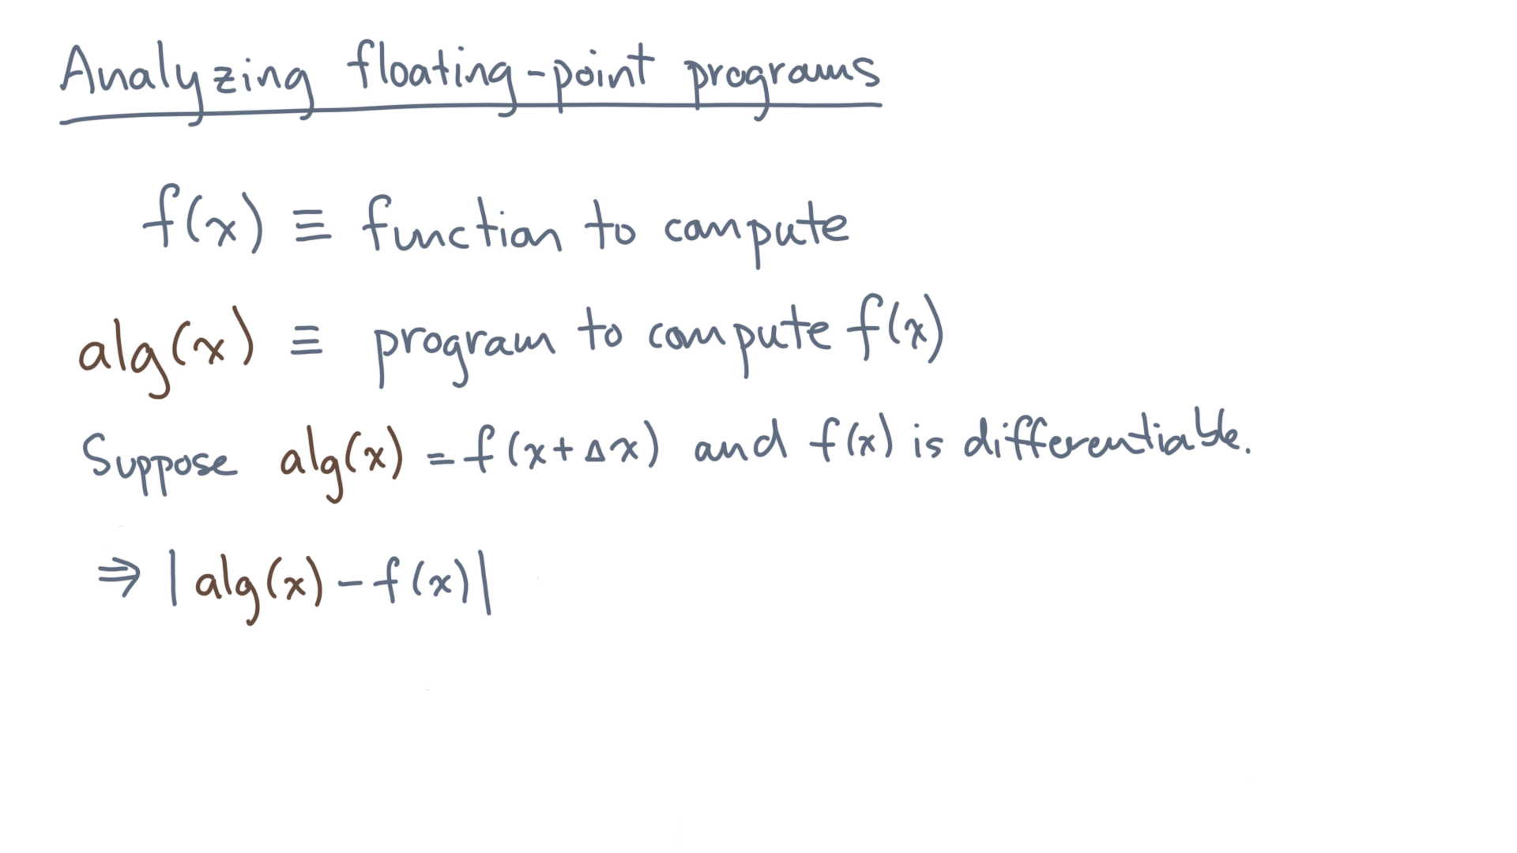
Notes:
What is the forward error?

Slide 25
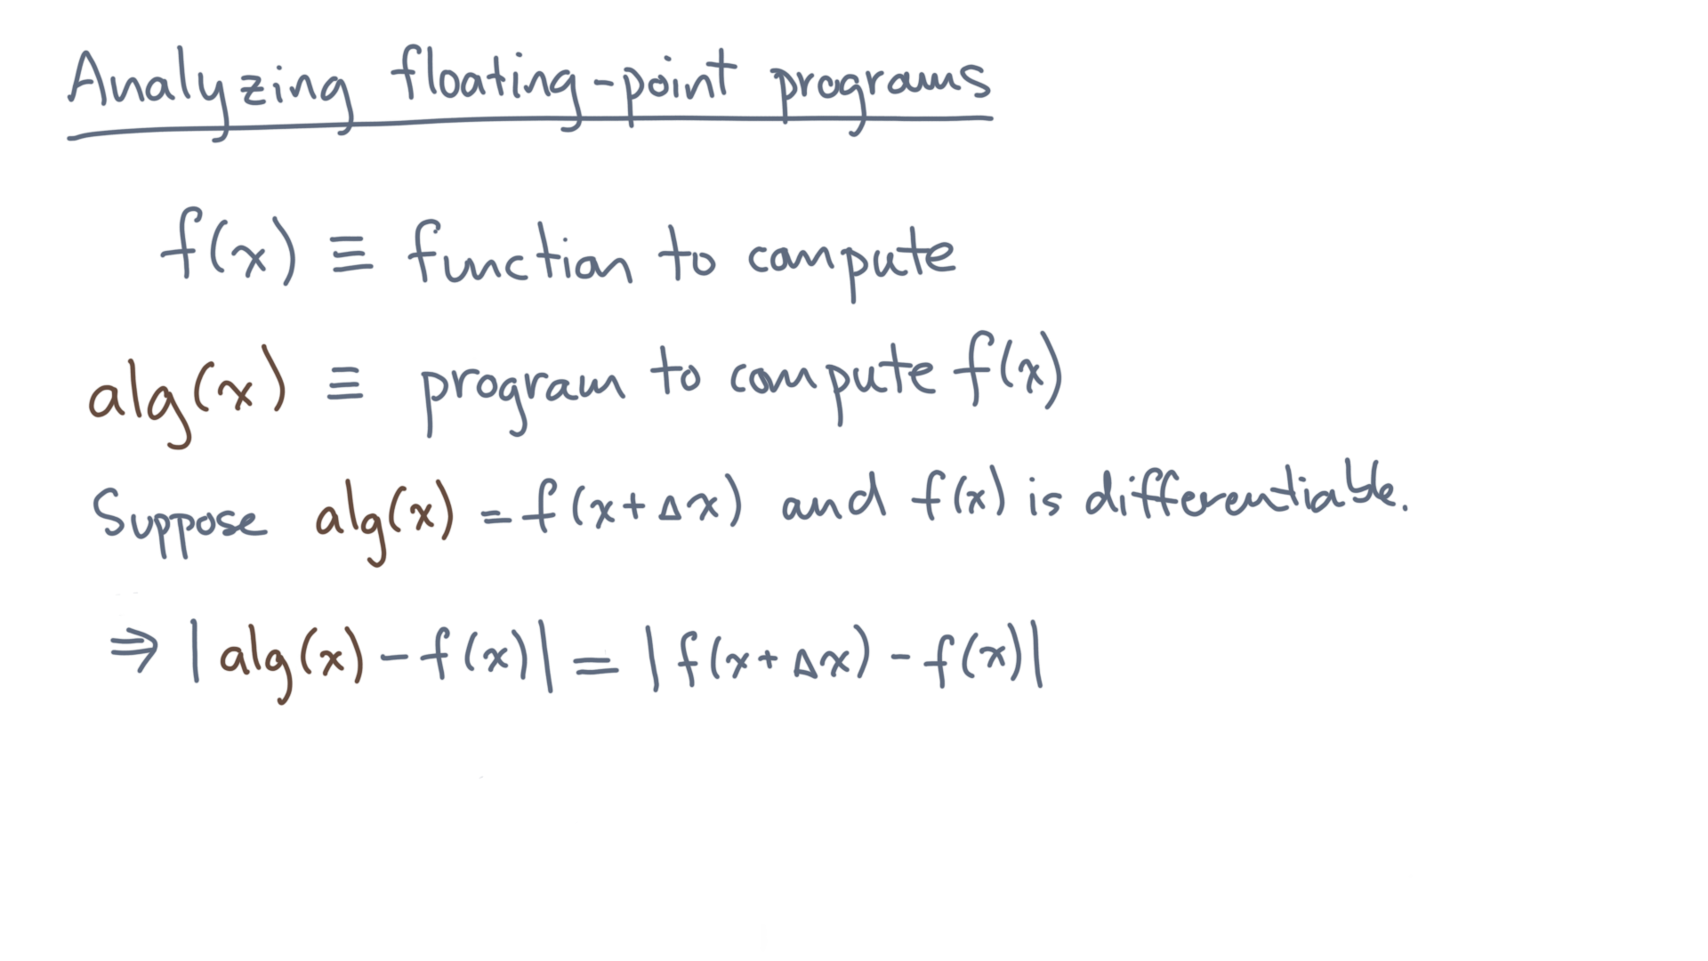
Notes:
It can be written as f(x + delta x) – f(x).
Now think back to calculus, when you were young and fancy free.

Slide 26
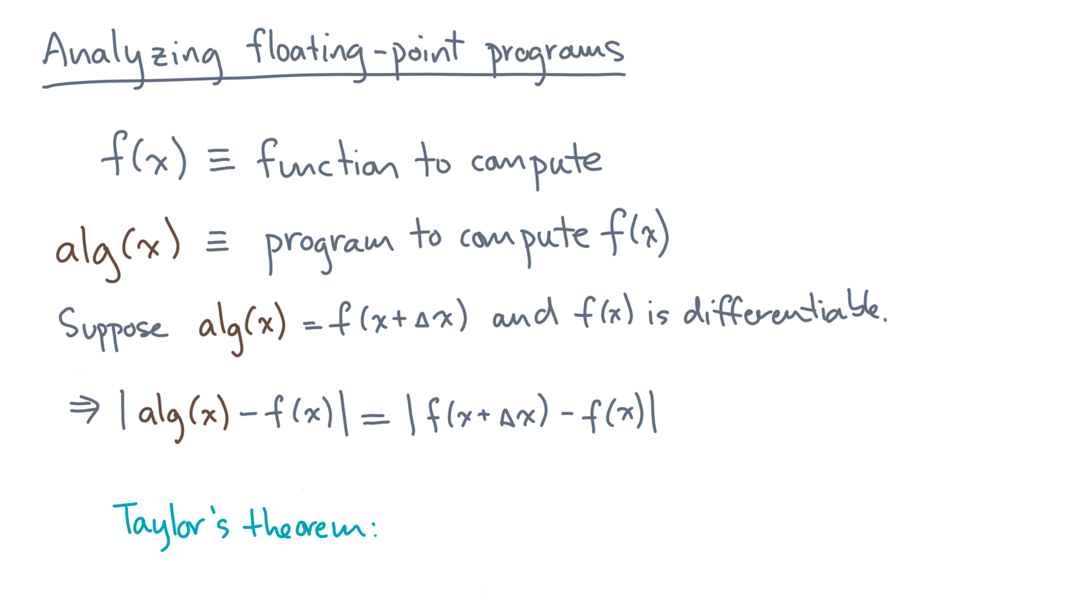
Notes:
Taylor’s theorem allows us to approximate f(x + delta x).

Slide 27
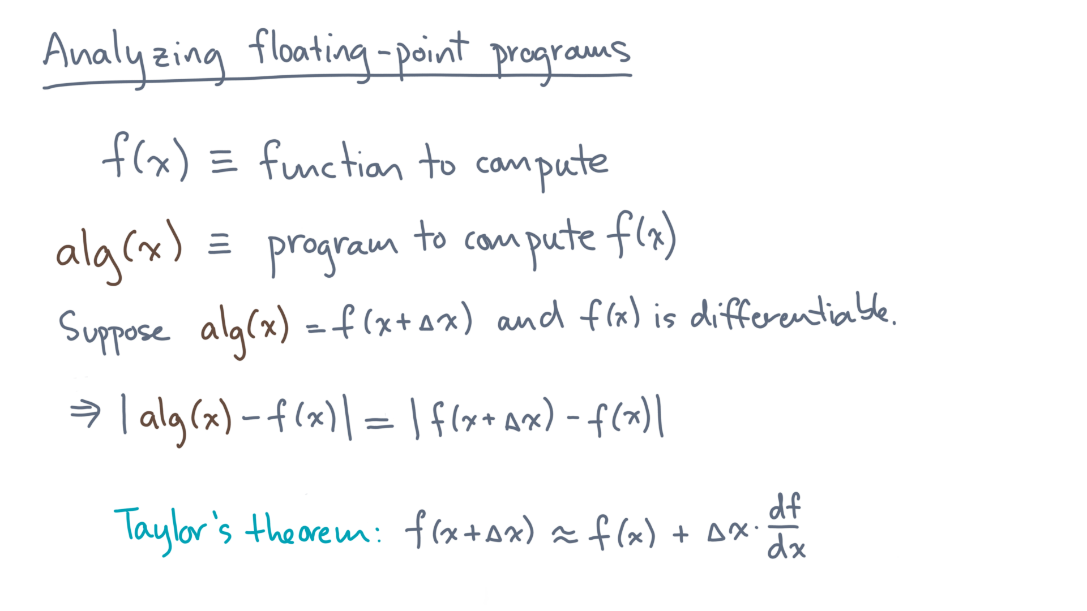
Notes:
It’s essentially f(x) plus delta x times the first derivative of f.
For this intuitive analysis, don’t worry about the first derivative too much yet; just assume we can compute it.
So, with Taylor’s theorem we can approximate f(x + delta x) minus f(x).

Slide 28
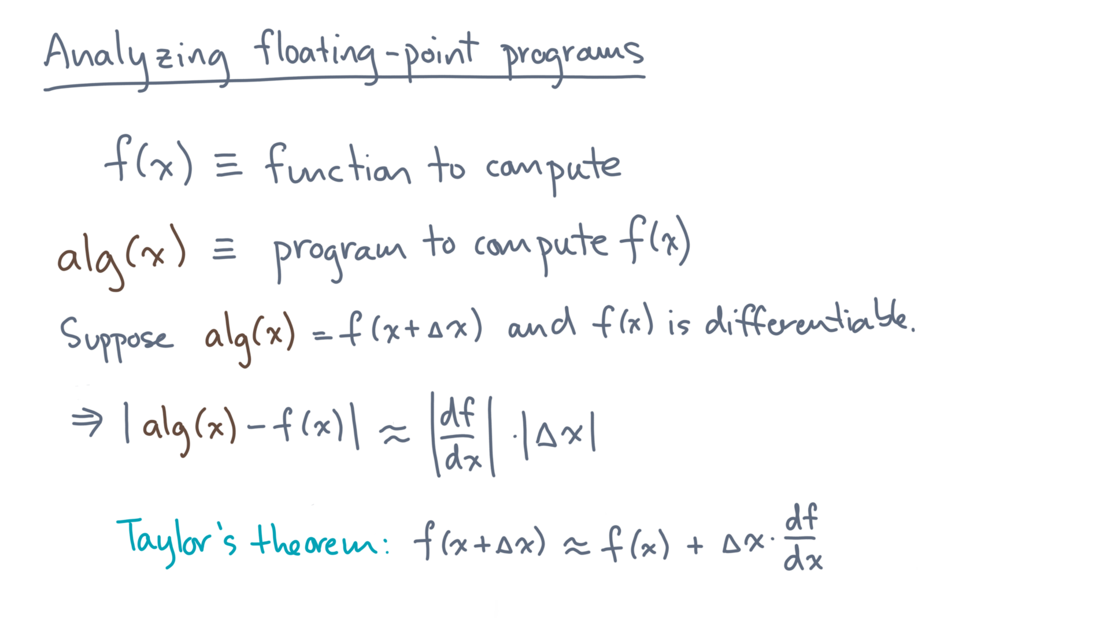
Notes:
It’s just the first derivative times delta x.
So why is that interesting?

Slide 29
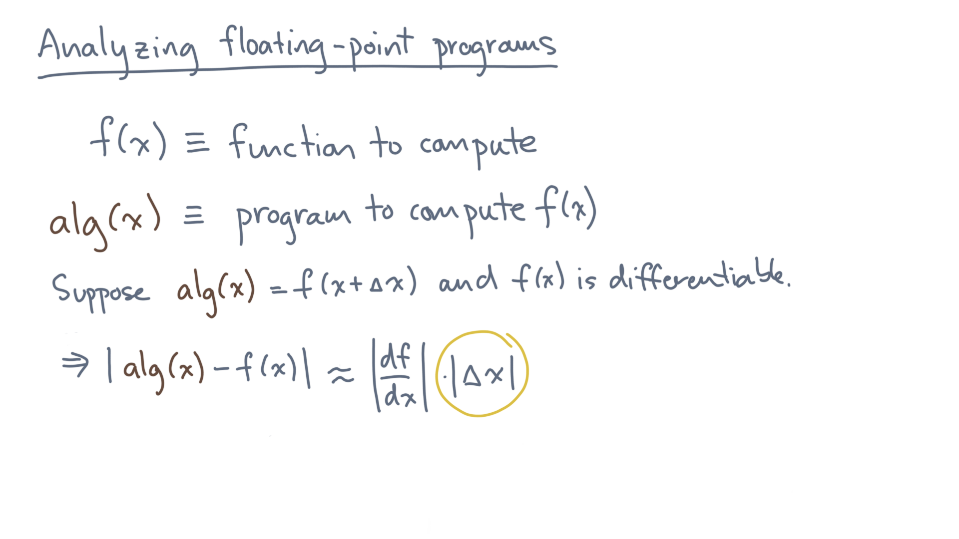
Notes:
Remember that delta x is the backward error.

Slide 30
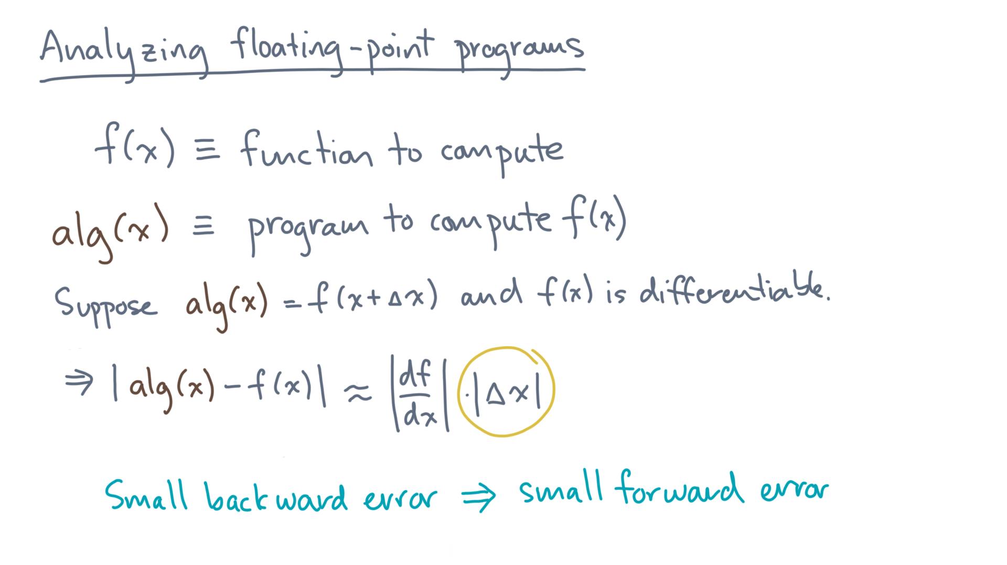
Notes:
So, if you manage to show the backward error is small, that implies that the forward error is also small.

Slide 31
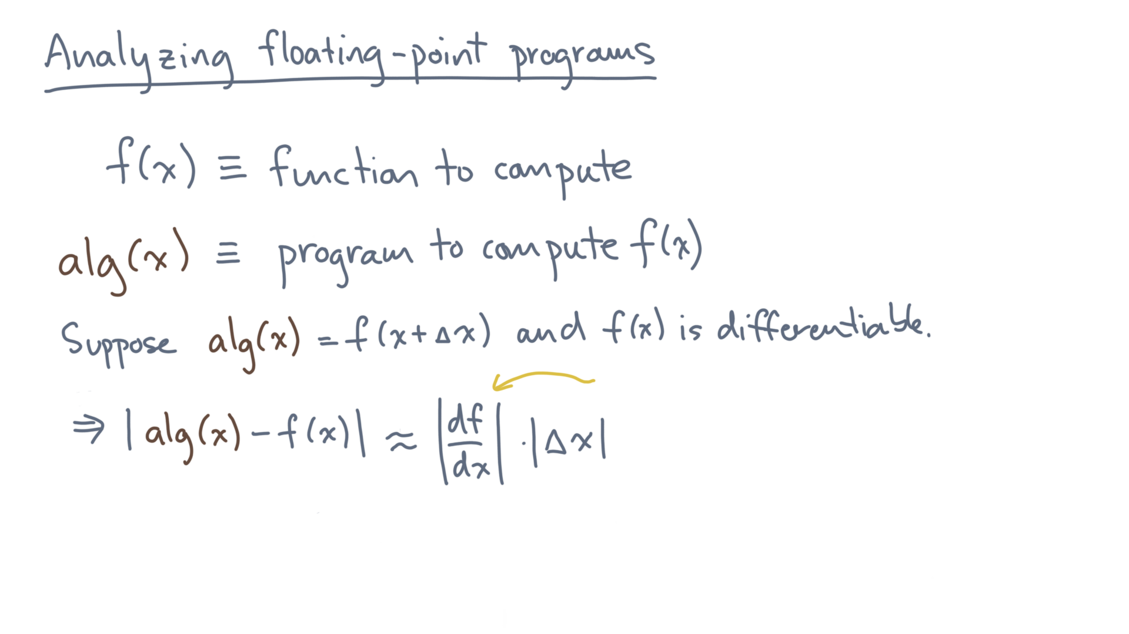
Notes:
Well, unless the first derivative is large.
Let’s defer that question for another day.

Slide 32
Notes:
So how are we going to analyze these forward or backward errors?
Let’s go back to the source of error that the computer introduces, which is rounding error, a consequence of finite-precision.

Slide 33
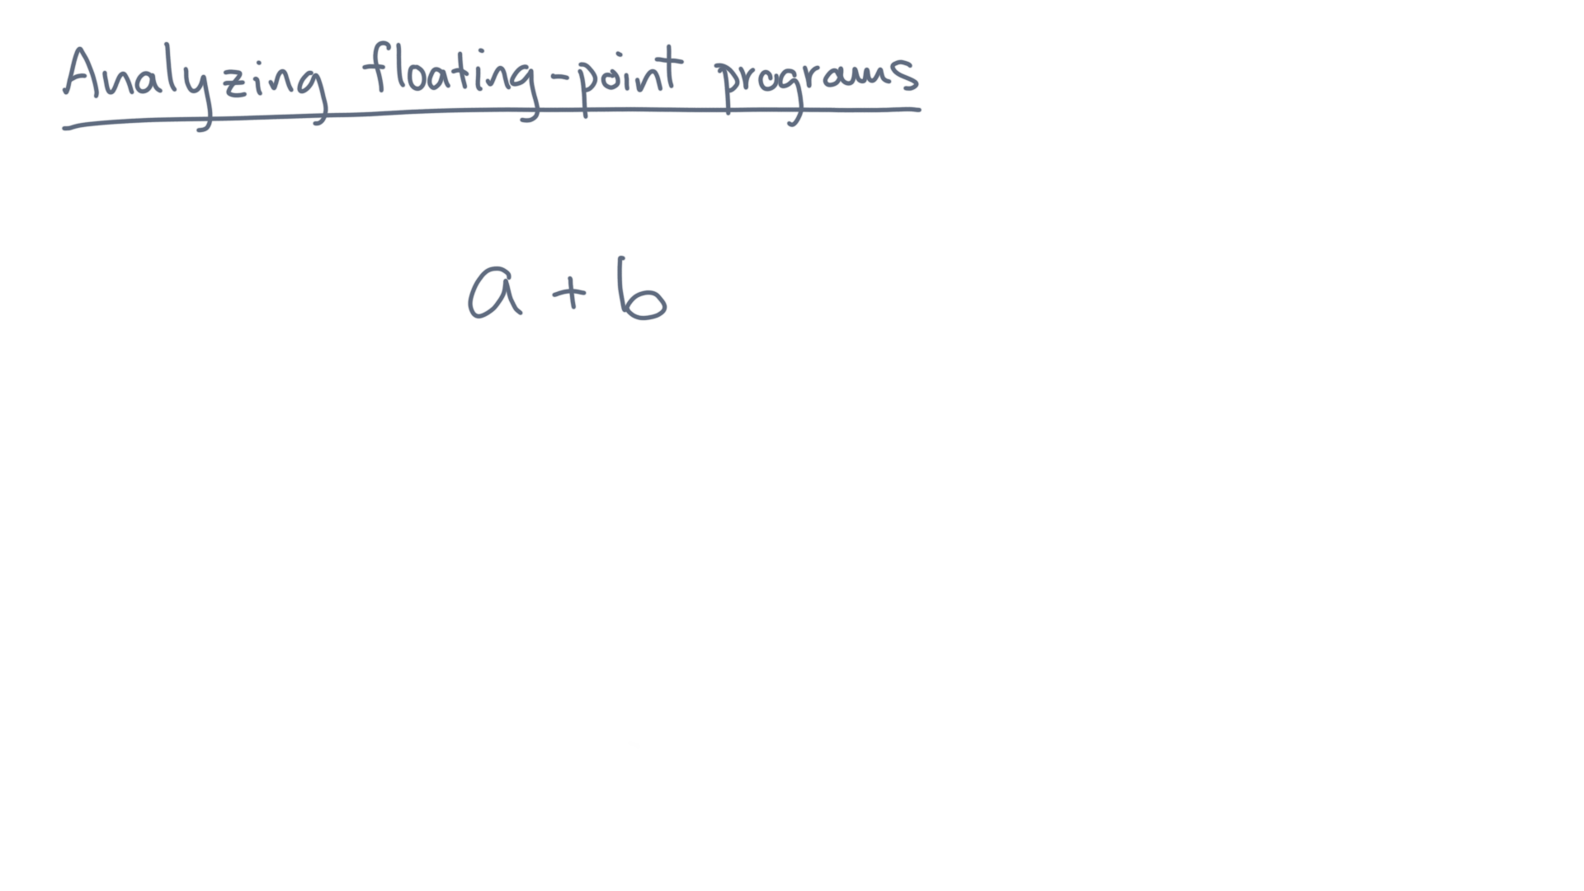
Notes:
Consider some operation, a plus b.
This is the exact value.
But a computer will produce something different.

Slide 34
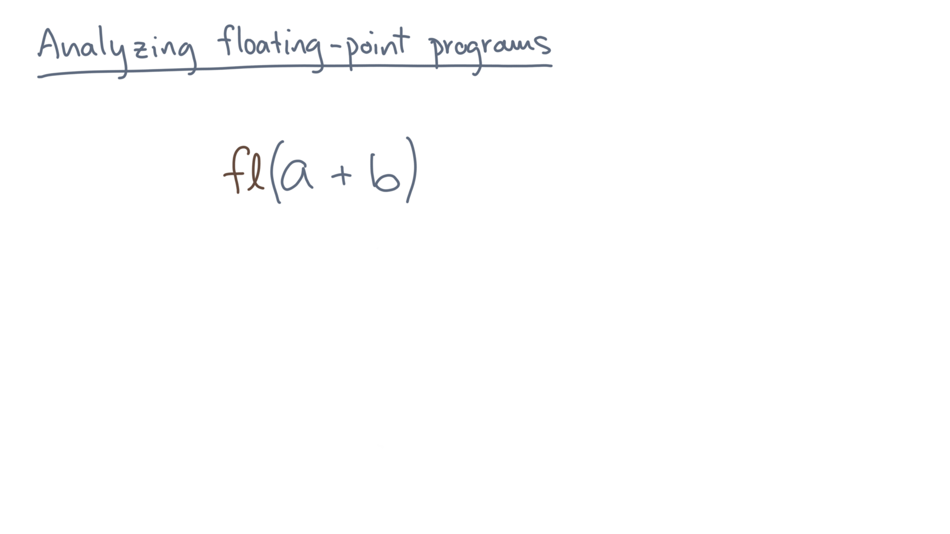
Notes:
Let’s call that “F-L-of-a-plus-b”.
Think of it as the truncated and rounded version of the true value, a plus b.

Slide 35
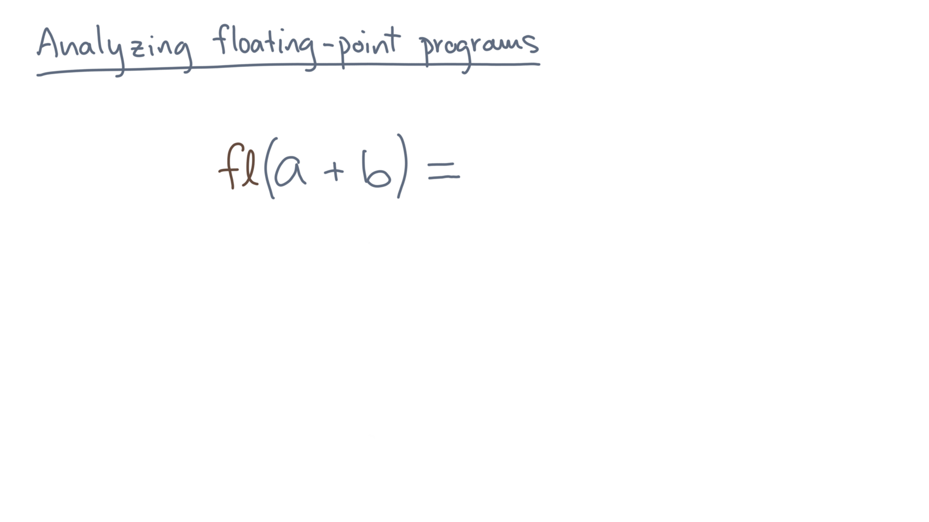
Notes:
What we need is a model for how this function behaves.

Slide 36
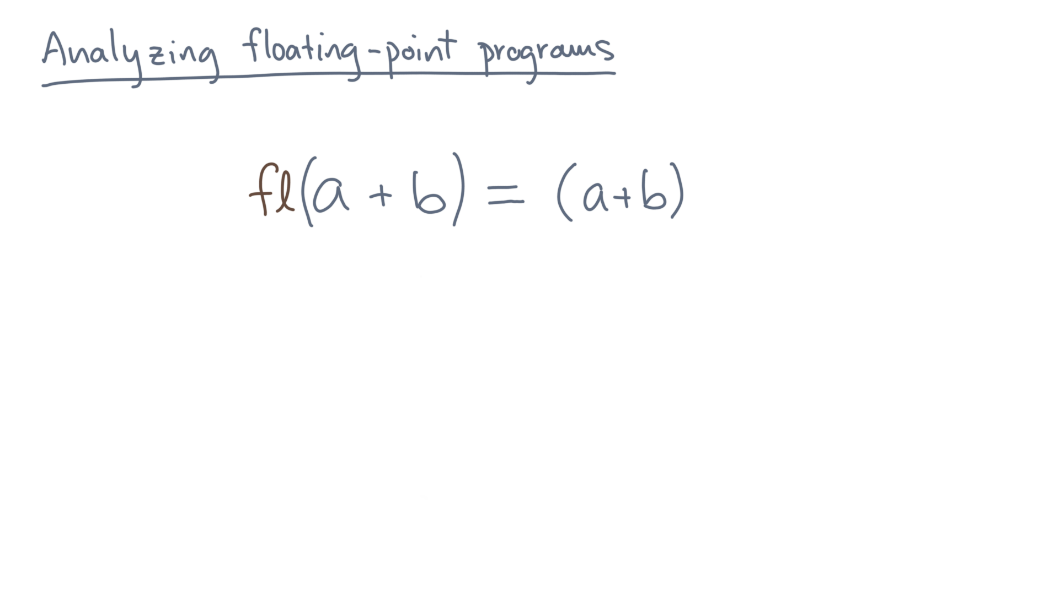
Notes:
Let’s start by saying it will be close to the true value, a plus b.

Slide 37
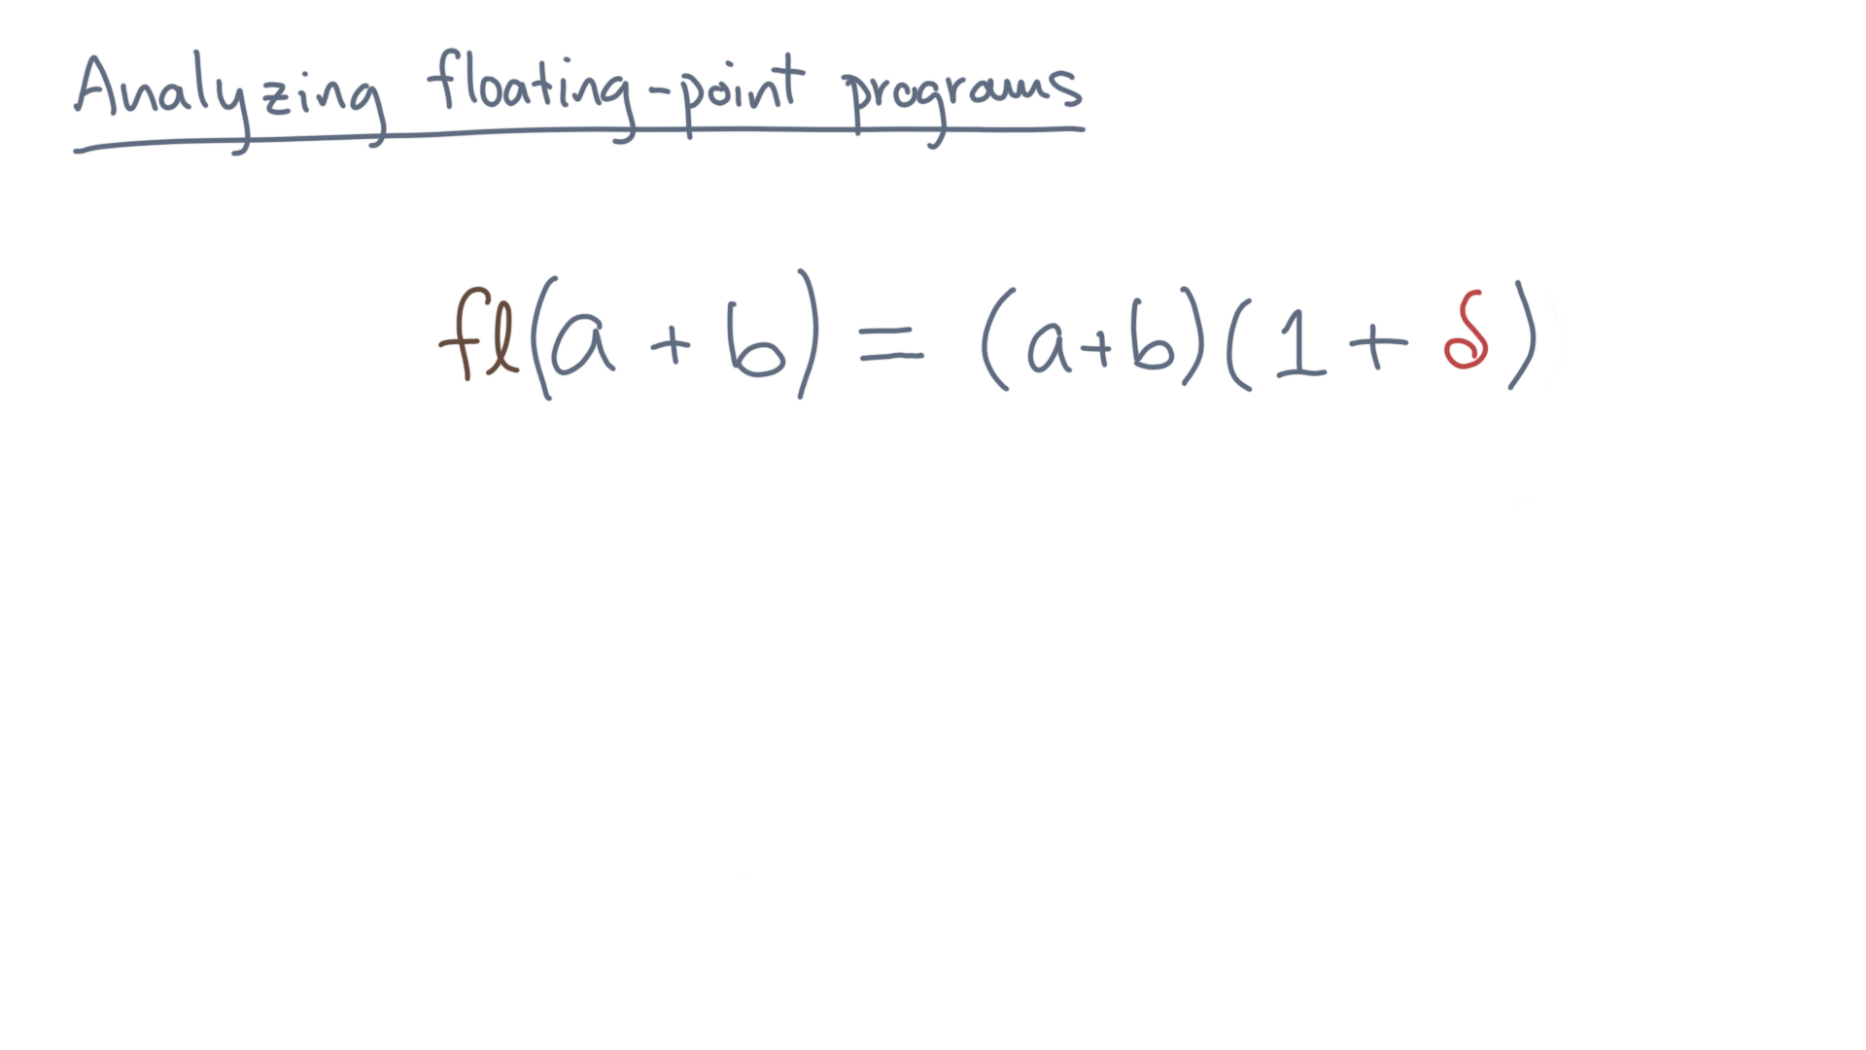
Notes:
However, what we get in floating point will be that true value times the quantity 1 plus delta.

Slide 38
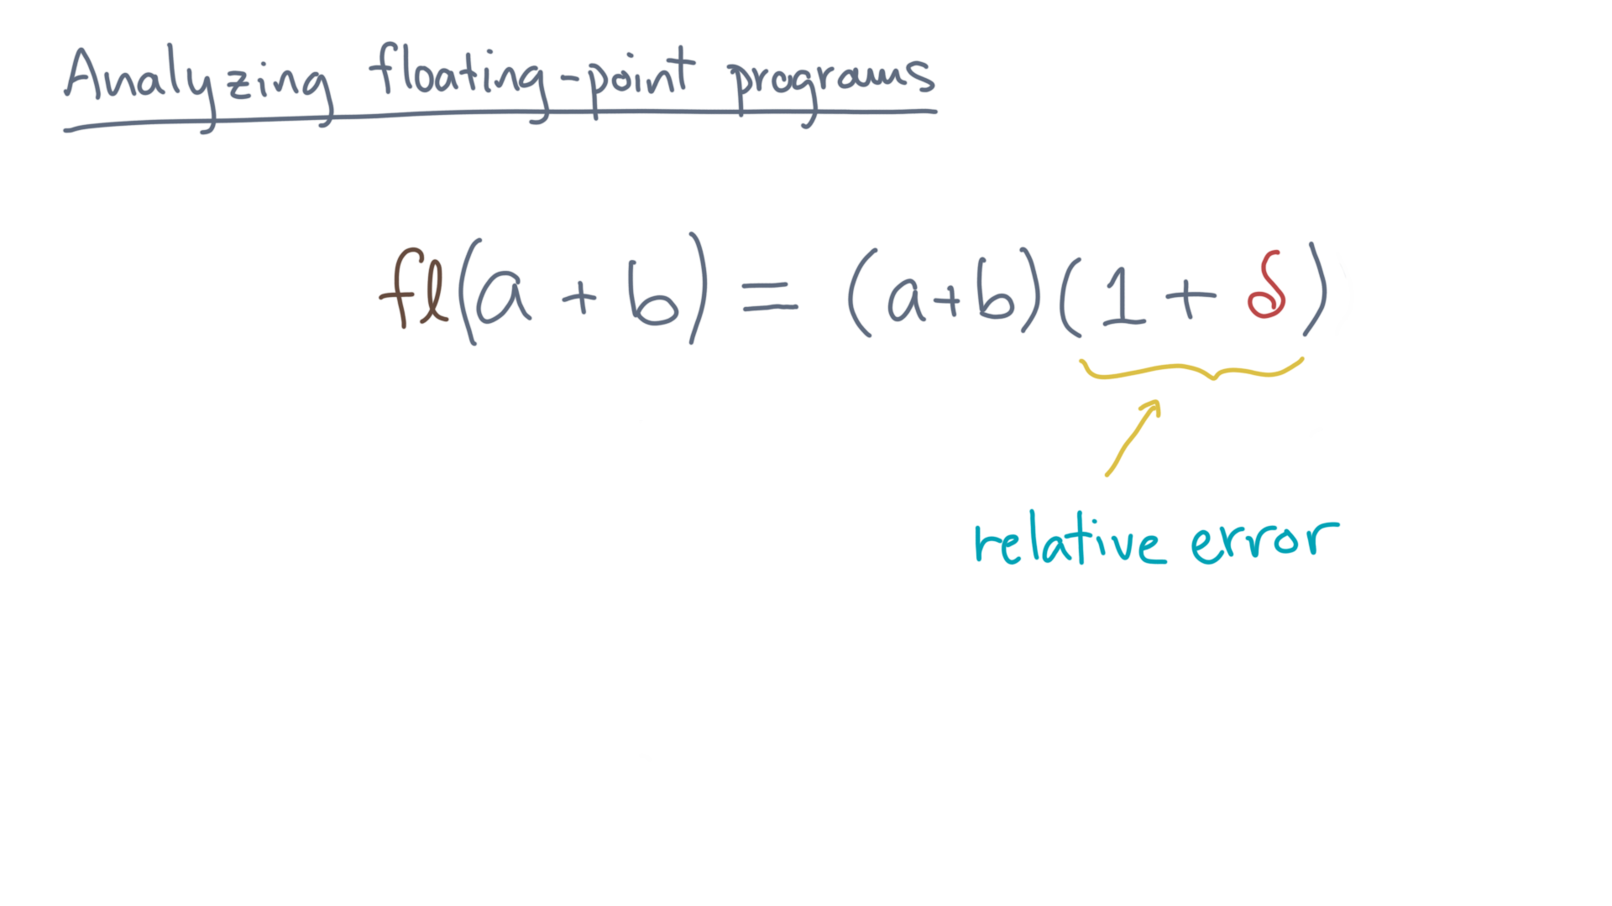
Notes:
One plus delta is a *relative error*.
So what can we say about delta?

Slide 39
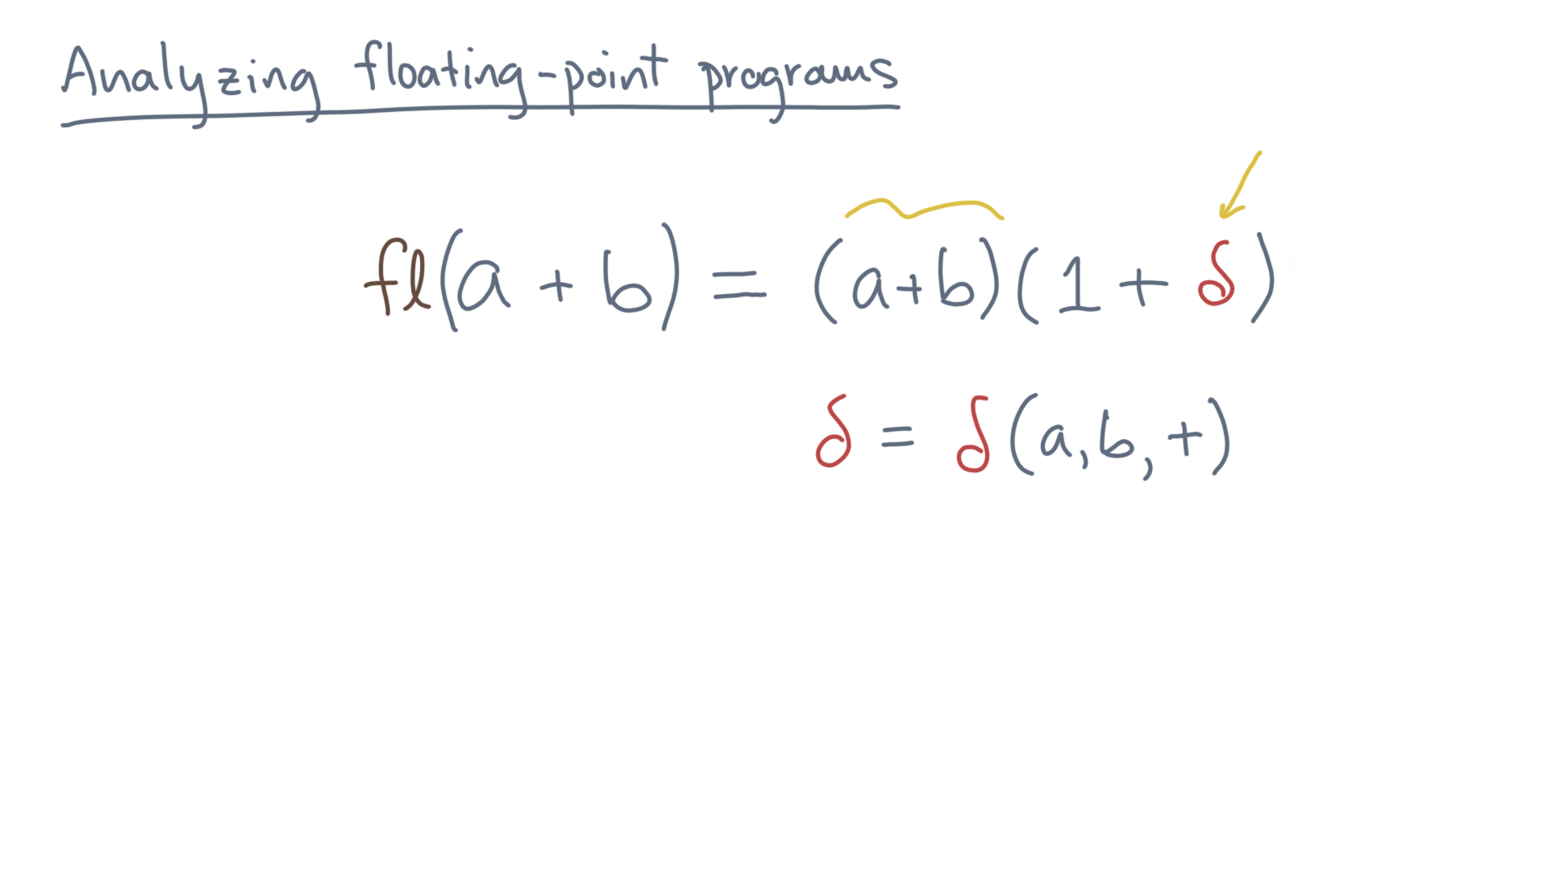
Notes:
First, note that delta will in general depend on the operands, a and b, as well as what operation we are doing.
That’s addition in this example, but you will have relative errors for other operations, like multiplication and division.

Slide 40
Notes:
Unfortunately, we usually have no idea *exactly* what the value of delta is, since we don’t know the true answer.
But from our understanding of floating point arithmetic, we *do* know its worst case value.

Slide 41
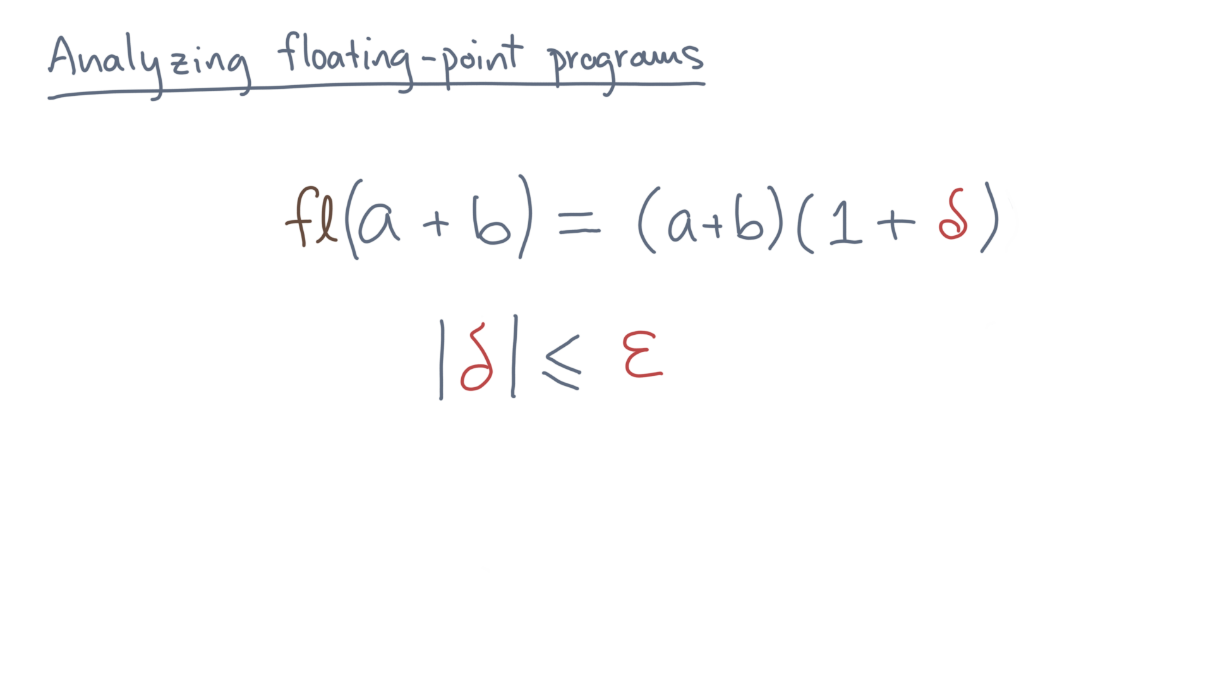
Notes:
And that value is epsilon!

Slide 42
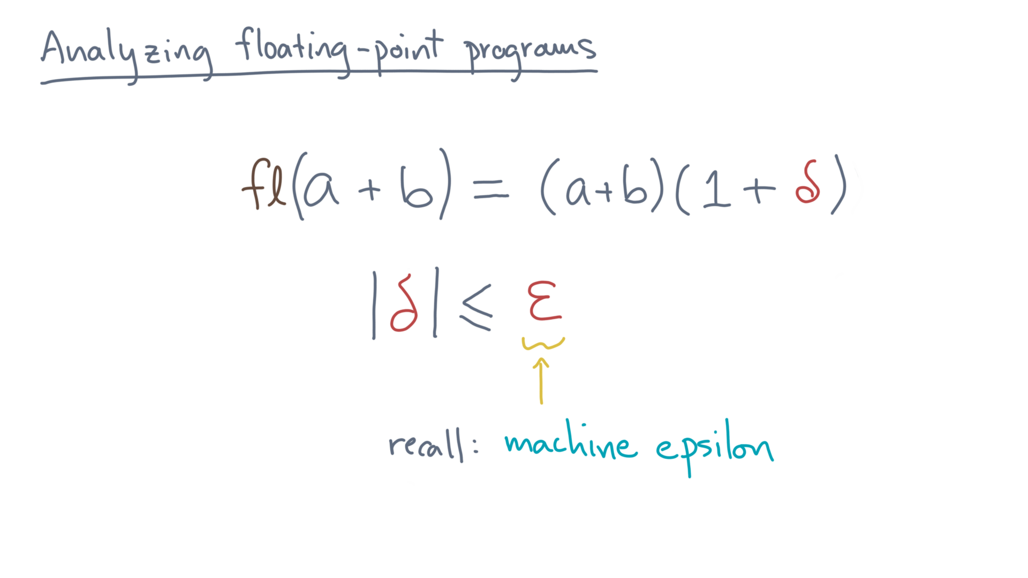
Notes:
As in machine precision.

Slide 43
Notes:
So let’s summarize where you stand.
Given a program or algorithm to compute a function, you want to bound its distance from that function’s true value.
Your measures of distance will be either the forward error or the backward error.
To actually, estimate forward and backward error bounds, you need a model of how floating-point arithmetic behaves.
For that, you went back to the storage formats.
That is, you saw that the concept of machine epsilon will give us a way to start reasoning about the worst-case rounding errors that a program might incur.
You now know a lot of detail about how numbers are stored.
But to show that a numerical program is correct, you’d like to avoid thinking about too many of those details, at least while you are trying to develop an algorithm.
So, in this lesson, you’ll get an overview of a high-level mathematical framework for analyzing errors.
Ok, so let’s get started.

